Slide 1
Coordinator Operations
LoGan Gowers
Graduate School Office of Fellowships & Benefits

Slide 2
Coordinator Operations
Role of the TBP coordinator
  Allocation
  Entering a Student (Traditional and XTBP)
  Running reports and Troubleshooting
Tuition Billing
Student Registration Requirements
Petitions

Slide 3
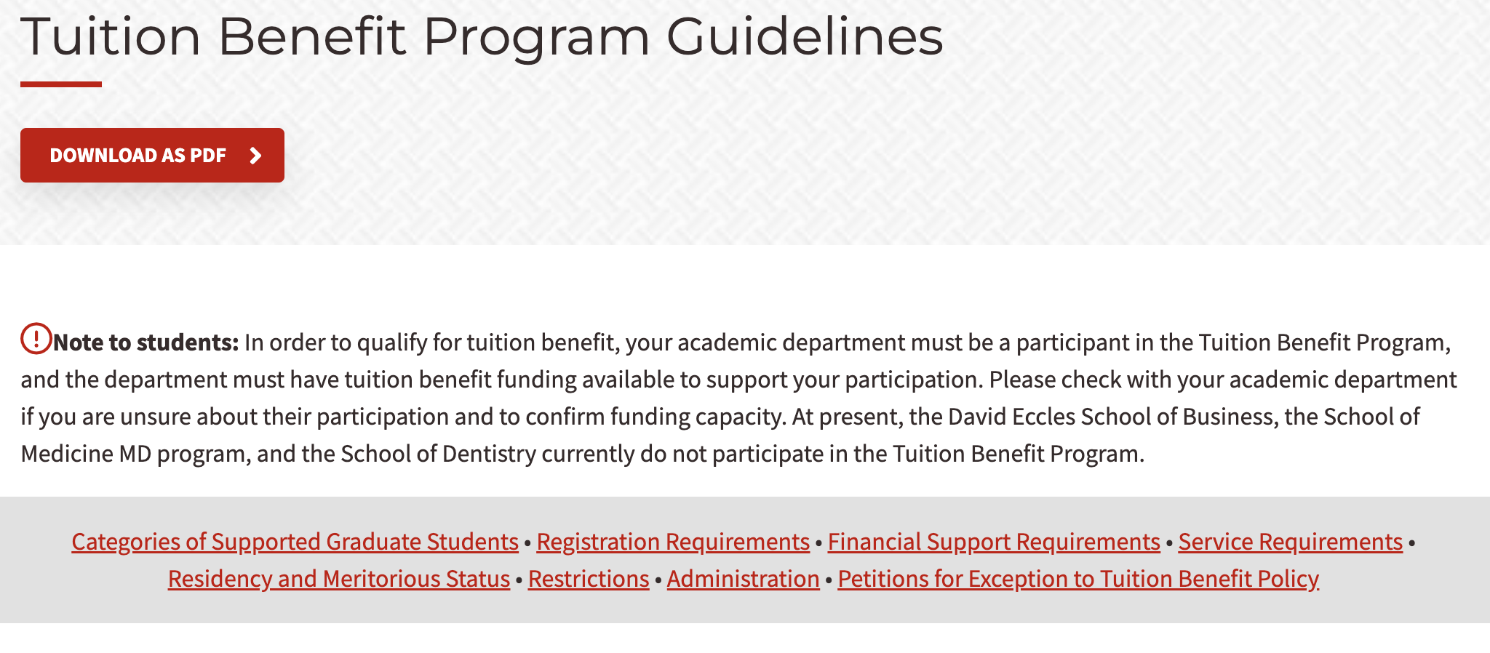
TBP Guidelines
gradschool.utah.edu/funding/tbp/guidelines.php

Slide 4
Role of Coordinator
It is the responsibility of each participating department to appoint an individual to serve as the primary tuition benefit coordinator.
Responsibilities include:
    Timely entry of students into the TBP portal
    Routinely running & reviewing coordinator reports
    Addressing TBP department and student concerns
    Liaising within the department pertinent tuition benefit concerns

Slide 5
Role of Coordinator
Department Liaison-
It is important to remember that the coordinator is our primary contact for your department regarding all TB concerns. As such, it is important that the coordinator be prepared to contact or work with any appropriate people within your department regarding issues that need to be remedied on the department side:
  HR concerns (Payroll, Job code Issues, etc.)
  Interacting with appropriate faculty and staff (such as PI or faculty/graduate advisors for students)
  First point of contact for students experiencing issues
  Additionally, the Coordinator should be the one to contact our department in the case of concerns, as to avoid unnecessary confusion with Faculty/Staff.

Slide 6
Allocation
Tuition Benefit is not an infinite resource
TBP dollars is provided by the University to each college. This is referred to as “Allocation”
Allocation is divided by departments at the discretion of the dean
Deans, or their designees, can reallocate funds throughout the year as necessary

Slide 7
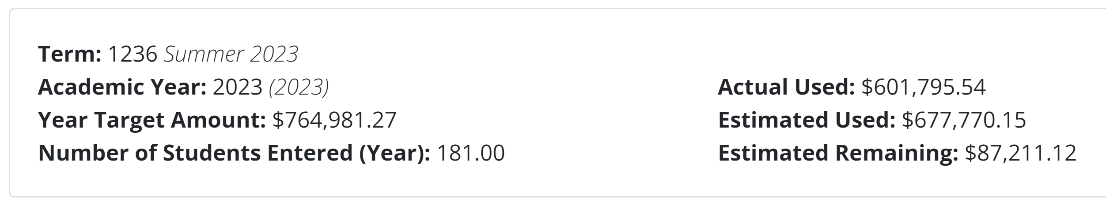
Allocation
Found at the top of your reports.
Year Target Amount is total granted allocation for the Academic Year.
System calculates per-student entered the max TBP will cover (12 graduate credits) and creates an “estimated used”
  AY23 max is $5,170
  System doesn’t currently prorate for 50% or 75% benefit or PhD dissertation reduced credit costs, but we’re working with UIT to implement
“Actual used” indicates the actual amount being used for resident tuition & mandatory fees, and this will generally be less than “estimated used.”
  This updates throughout the semester in real-time (as much as possible), in accordance with whenever students earn/receive minimum support amounts.
Estimated remaining is the difference between Year Target Amount and Estimated Used.
You may encounter issues in Spring/Summer if “estimated” is near target – reach out to the tuition benefit team to troubleshoot

Slide 8
Allocation
It is important for each department to budget for the entire academic year. Allocation that runs out early in the year leaves later students without support.
Departments should look ahead at whether students will be on TBP during the summer, as well as if fall or spring are equal in TBP students or not
Example: using TBP for the same number of students during fall and spring only: $250K total, target use of only $125K/semester

Slide 9
Allocation
Concerns over tuition benefit allocation increase needs should be directed to your dean’s office
Dean may choose to reallocate from one department to another
Department/college may have funding for XTBP
Proactively anticipate strategic growth and include those TBP needs in the annual budget request

Slide 10
Allocation
Allocation covers the resident tuition & mandatory fees for the following students:
Research assistants, non-project-funded (GRs)
Teaching assistants (TAs, GTs)
Graduate fellows (GFs)

Slide 11
Allocation
What isn’t charged to the allocation:
Research assistants, project-funded (RAs) – charged to F&A returned overhead
Students on XTBP (TA, GT, GR, GF, and RA) – charged to the chartfield(s) provided at time of entry
Non-resident tuition waivers
Charges outside of resident tuition and mandatory fees (as defined by the University as “mandatory fees), such as differentials, international student surcharge, etc.

Slide 12
Tuition Billing
Tuition is assessed by the Office of Income Accounting
Students are billed according to their residency status (Utah resident, domestic non-resident, international)
Eligible domestic non-resident & international students will have a non-resident tuition waiver applied to tuition in addition to tuition benefits

Slide 13
Tuition Billing
Dissertation Credit Billing Reduction
Limited to 1) PhD students, and 2) enrollment in eligible dissertation credits (catalog range 7970-7989)
Dissertation credits billed at a reduced rate of approximately 1/3 (after zero hour fee)
Tuition is assessed by course; students in a mix of dissertation and coursework will have dissertation charged at the reduced rate and coursework at the usual rate

Slide 14
Tuition Billing
Tuition Benefit Covers | Tuition Benefit Does Not Cover
Resident tuition up to 12 graduate credits (up to 6 graduate credits during summer) Mandatory fees Non-resident waiver, where applicable and eligible | Differential tuition Fees outside of mandatory fees Undergraduate courses Repeated courses (outside those required by curriculum) Graduate credits exceeding 12.0 Non-credit/continuing education courses Withdrawn courses Audited courses International student fees Non-resident waiver for RAs after reaching 84 cumulative graduate credits

Slide 15
Tuition Billing
RA 84-Credit Hour Rule
Students supported on TBP as RAs (9314) concurrent to the semester(s) in which they have met or exceeded 84 cumulative graduate credits will be responsible for the non-resident portion of their tuition.
Affected student who have completed required coursework may enroll in thesis/dissertation hours (9 credits – no more/no less).
Departments choosing to cover the non-resident charges can do so through Scholarship Administration

Slide 16
Student Support
Assistantships
  Graduate Research Assistant (RA, 9314)
  Graduate Assistant – Research Focus (GR, 9330)
  Graduate Teaching Assistant (TA, 9416)
  Graduate Assistant – Teaching Focus (GT, 9417)
Fellowships
  Graduate Fellow (GF)

Slide 17
Student Support
Students supported by assistantships
For federal tax purposes, TBP job codes are only to be used when students are supported by TBP in an assistantship that is related to a student’s educational and professional objectives
Wages will only count toward tuition benefit minimum support when:
  Earned on appropriate job code(s)
  Earned during the appropriate pay periods (e.g. Fall support must be earned between August 16 and December 31)

Slide 18
Student Support
Students may be supported in more than one classification, such as the following examples:
Student working in a lab on faculty start up, but grant funding becomes available mid-semester – student would be a mix of RA and GR
Student working in a limited teaching assistantship, such as 10 hours a week, and also receiving a graduate fellowship – student would be a mix of TA and GF

Slide 19
Student Support
GRs working outside of their academic department
Must be approved by the Graduate School each academic year
Petition must include the job duties and the curricular connection to the job duties
Petition for approval regardless of the following:
    Student was approved for that assistantship in a previous academic year
    Student is supported on XTBP

Slide 20
Student Support
Students may be eligible for subsidized health insurance when supported on an assistantship (no GFs) at the 100% benefit level
Department must have a benefit allotment to cover the 100% premium, unless student is a TA paid on 1001 funds (premium covered by a central benefit pool)

Slide 21
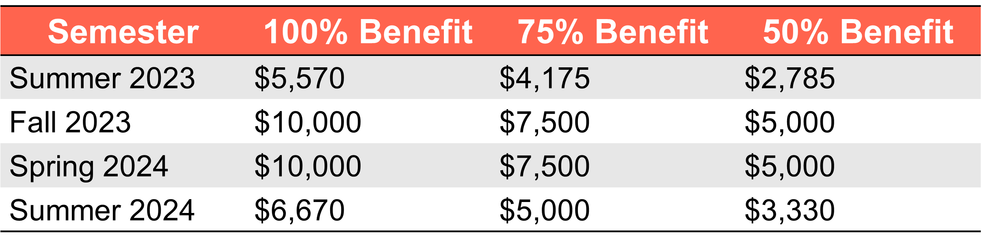
Student Support
Minimum support levels increase every academic year to anticipate growth in student needs (similar to a cost-of-living adjustment). Departments should anticipate these numbers to increase regularly and plan their offers accordingly.
Final numbers are approved by the University President’s Office.

Slide 22
Entering a Student
Entry of Benefits-
TBP portal opens for student entry six weeks prior to the first day of school
Portal will remain open until the campus census
Department’s responsibility to have students entered into the system in a timely manner
Retroactive benefits are not processed

Slide 23
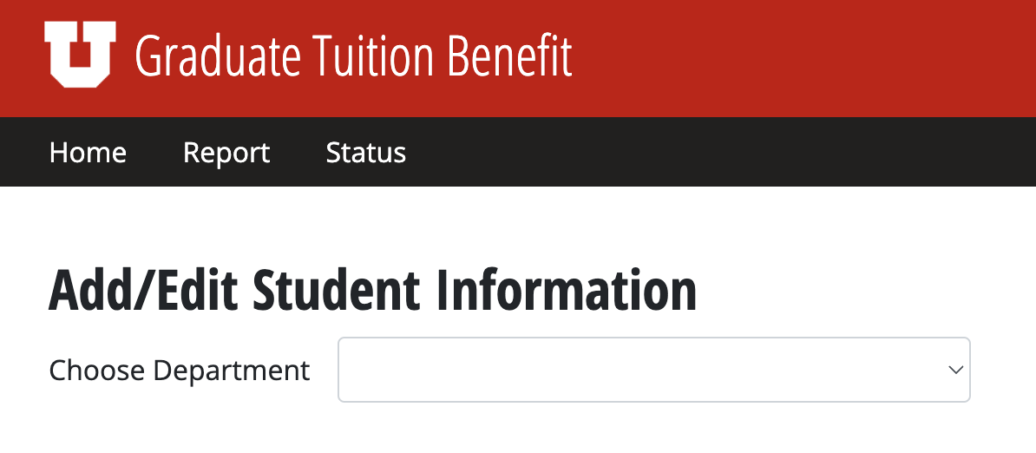
Entering a Student

Slide 24
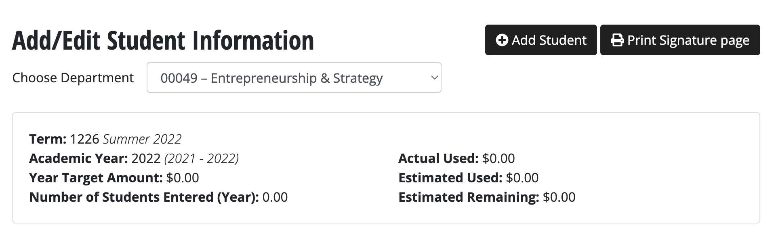
Entering a Student

Slide 25
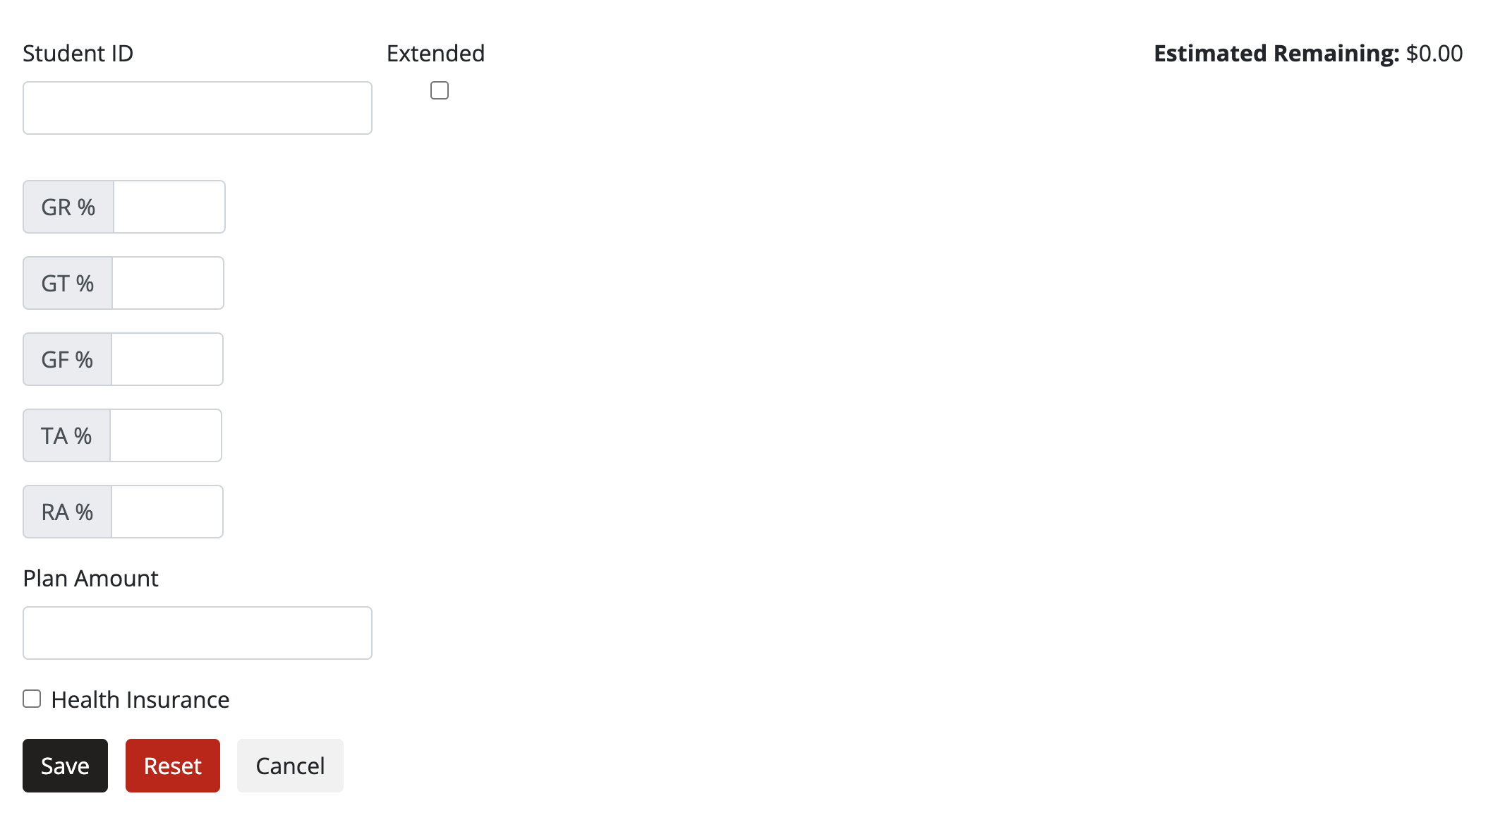
Entering a Student

Slide 26
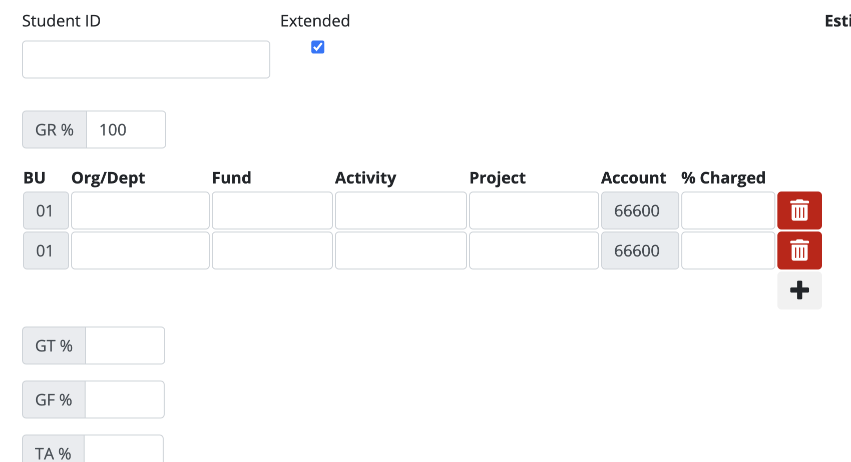
Entering a Student

Slide 27
Entering a Student
Enter student prorations as accurately as you can estimate
We understand that grant funding comes/goes mid-semester causing job code changes (GR to RA, RA to GR, etc.)
Proration changes should be sent to the tuitionbenefit@gradschool.utah.edu

Slide 28
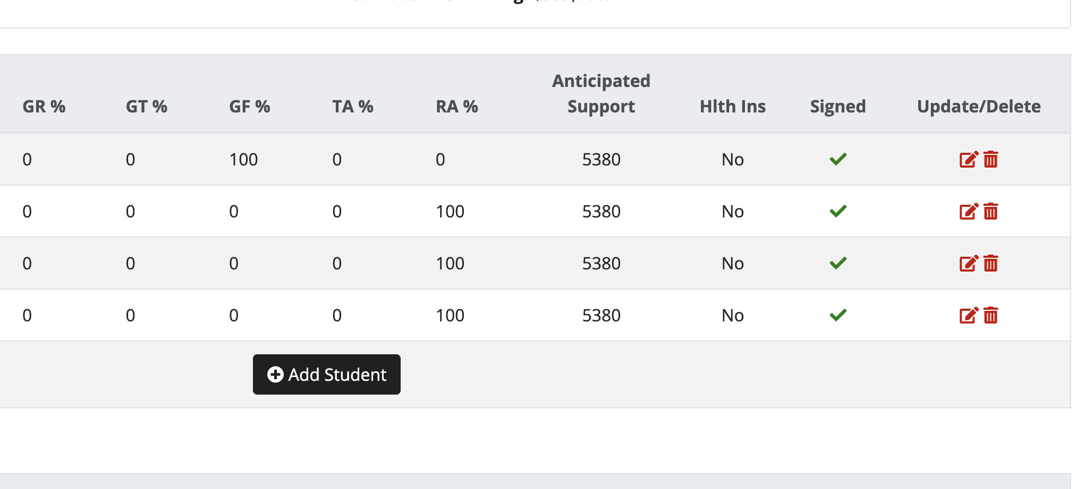
Entering a Student

Slide 29
Running Reports
It is the responsibility of the coordinator to run and review reports on a regular basis
Regular review ensures that errors are attended to, problems can be anticipated and proactively solved, and that benefits are appropriately being applied
Should TBP-adjacent responsibilities (ePAF processing, Scholarship Admin, payroll, etc.) lay with others in the department, it is the coordinator’s responsibility to share the report/communicated concerns in a timely manner

Slide 30
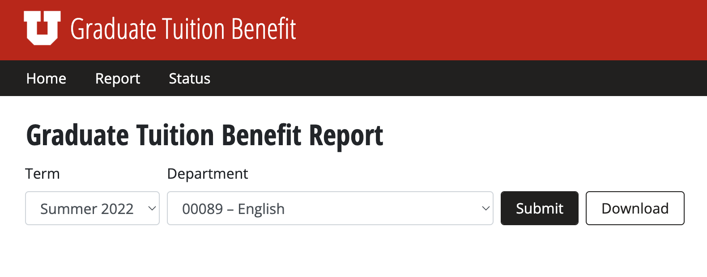
Running Reports

Slide 31
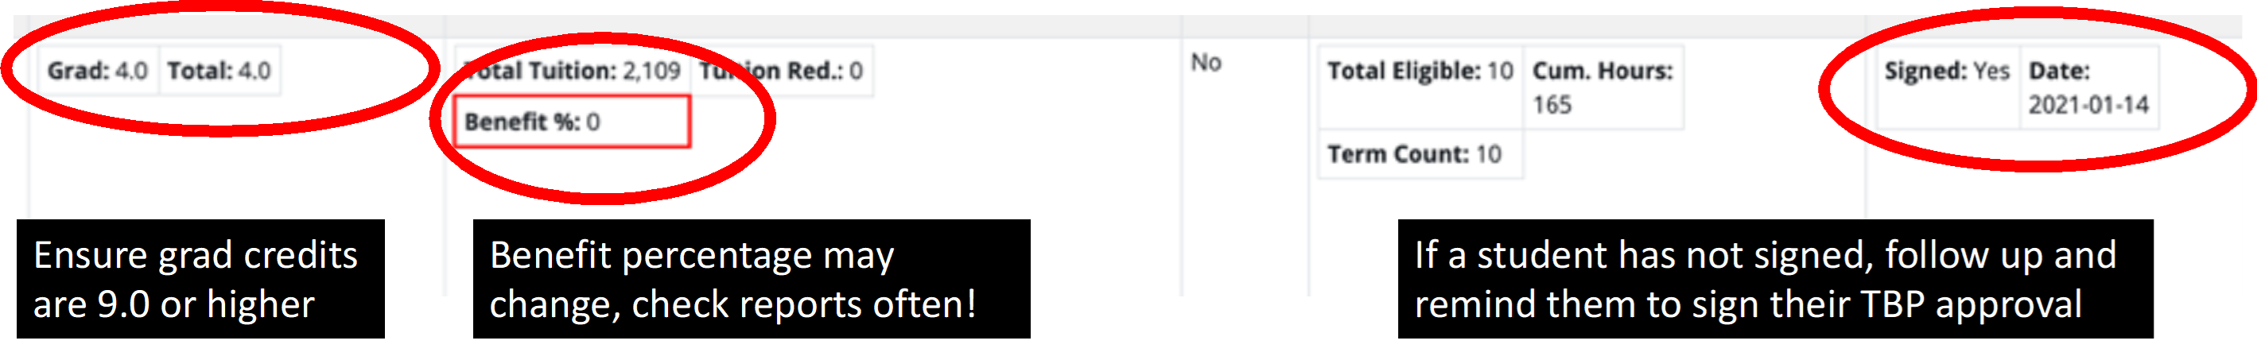
Running Reports
Designates GSHIP election

Slide 32
Running Reports
Common Error Messages
No RA Job 5K Fd –student is an RA, but not at that moment on an active RA job record
No TA Job Code – student is a TA for the semester, but not at the moment on an active TA job record
Insufficient Credit Hours – student is not enrolled in the minimum required number of credits
84 Hours Exceeded – student is an RA and has a cumulative credit hour calculation of 84 or more
TBP Term Count Exceeded – student has no more terms of eligibility remaining
Override: Eligible –override has already been processed

Slide 33
Financial Support Requirements
Assistantship wages will only count when earned during the proper semester:
    Fall : August 16 thru December 31 (9 pay periods)
    Spring : January 1 thru May 15 (9 pay periods)
    Summer: May 16 thru August 15 (6 pay periods)
Fellowships will only count when:
    Disbursed through Scholarship Admin during the proper term (fall, spring, summer)
    Stipends paid through AP disbursed within the semester

Slide 34
Enrollment/Registration
Students participating in the Tuition Benefit Program (including XTBP) must meet the following requirements:
Matriculated graduate student
In good academic standing with program
Enrolled in a minimum of 9 credits (fall/spring) or 3 credits (summer); tuition benefits will not disburse if enrollment requirement is not met

Slide 35
Enrollment/Registration
Nine Credit Enrollment Requirement
TBP will cover 9-12 graduate credits
TBP does not cover undergraduate or repeated courses (outside those required); however, these courses can count toward the 9 credit minimum

Slide 36
Enrollment/Registration
Repeated courses
Tuition benefit will cover if required by degree program (usually thesis/dissertation)
TBP will not cover repeats for a higher grade or to refresh, even if program requires a student to retake a class for a higher grade

Slide 37
Enrollment/Registration
Academic Year Limits
Academic year defined as Fall, Spring, and Summer semesters
  (Starting in Fall and ending in Summer)
If a student is supported on TBP Fall & Spring, they will have an AY limit of 24 graduate credits
If a student is supported on TBP Fall or Spring semesters, they will have an AY limit of 12 graduate credits
Example: a student supported on TBP the entire AY may choose to enroll in 9 credits Fall, 9 credits Spring, and 6 credits Summer

Slide 38
Enrollment/Registration
Enrollment Accommodations
TBP will honor a reduced enrollment accommodation as approved by the Center for Disability & Access (CDA)
No other accommodations will be granted without CDA approval

Slide 39
Enrollment/Registration
Withdrawn Courses
A withdrawn course are credits a student has removed from active enrollment after the semester add/drop deadline
Tuition benefit does not cover withdrawn courses
If a student’s active enrollment remains 9 credits or higher, TBP will be applied as usual and student will be responsible for withdrawn course
If a student’s active enrollment drops below 9 credits, they will no longer be eligible for tuition benefits

Slide 40
Petitions
Petitions may be submitted on behalf of a student by a department chair, or chair’s designee
Exceptions considered for personal emergencies such as illness or extenuating family circumstances
Petitions should be sent to tuitionbenefits@gradschool.utah.edu
  A new portal for petition submission is in the process of being created at this time. That portal will be available online on our website on a future date. When that portal is complete, all petitions will be submitted via that option instead. Notice will be sent to coordinators when that goes live.

Slide 41
Petitions
To be eligible for a TBP petition, a student must meet the following requirements:
Remain in good standing in their academic program
Formation of a committee
Grad Student Degree Tracking up to date (including program of study entered and approved by committee)
Qualifying exams completed
Completion of other milestones as required by a degree program to define good standing

Slide 42
Petitions
If a tuition benefit extension is granted, the department will be responsible for the following:
Providing minimum required support (assistantship and/or fellowship)
Having tuition benefit allocation (for TA/GT/GR/GF) to cover resident tuition & mandatory fees or having costs charged to & F&A returned overhead (for RA)

Slide 43
Petitions
Alternatives to Petitions for TBP Extension
If student is an RA and their support is paid by a research grant, the PI of the grant can pay the tuition directly from grant funds (XTBP)
Use of departmental funds, reimbursed overhead, donor funds, or faculty startup accounts to cover tuition directly (XTBP)
If no other options are available, a student may register for the minimum credit hours necessary to maintain continuous registration (1 credit hour) and pay directly
  (3 credits may be required for visa, student loan, and or health insurance eligibility)

Slide 44
Upcoming Workshops
June 2, 11am – TBP & Enrollment Management
June 6, 11am – GSHIP Overview
July 6, 11am – TBP Fall Prep F&Q
August 2, 11am – Graduate School Funding Opportunities

Slide 45
Questions?
LoGan Gowers
Tuition Benefit Administrator
Graduate School
801-585-1372
L.Gowers@utah.edu
For general Tuition Benefit Program assistance, email tuitionbenefit@utah.edu
For fellowship concerns, email fellowships@gradschool.utah.edu
To schedule meetings, email L.Gowers@utah.edu
A copy of this presentation (both slides and video) will be made available on our website under “Coordinator Resources” within the next few days.

