Slide 1
Graduate Subsidized Health Insurance Program (GSHIP)
Jennifer Ehlers
Manager, Accounting and budget

Slide 2
Glossary terms
GSHIP
Graduate Student Health Insurance Program
Department-Paid –
Some department choose to subsidized or fully cover insurance premiums for students who are not eligible for GSHIP. This is department-paid insurance.
Some departments may offer dependent coverage
Voluntary (Direct) Coverage
A student who is not eligible for GSHIP and does not have department-paid options available to them can enroll in the insurance directly and pay the full premium.
Must enroll during Open Enrollment period for UHSCR
Must be enrolled in three (3) or more credit hours
The University of Utah policy has a continuation clause. If the student was covered (GSHIP/Dept Paid) in the fall or spring, then the student may enroll in continuation coverage. They can enroll directly through MyAccount on UHCSR’s website.

Slide 3
What is gship?
The official insurance program administered by the Graduate School, for those students who qualify for subsidized insurance through the tuition benefit program.
Coverage for dependents is NOT subsidized
The department/program may offer dependent coverage through department paid insurance
Health insurance carrier is UHCSR (United Healthcare Student Resources)
Same student health insurance policy offered to all U students
Vision/Dental insurance carrier is EMI (Educators Mutual Insurance)

Slide 4
Effective Dates
GSHIP
Department-paid
Fall Semester
8/16 – 12/31
Spring/Summer Semester
1/1 – 8/15
Departments have flexibility to add students during the semester
They can also have Fall, Spring, Summer only coverage
We’ve had instances where departments have added coverage mid-month

Slide 5
Eligibility
ELIGIBLE
NOT ELIGIBLE
Eligible Assistantships
Research Assistants
Teaching Assistants
Grad Assistant – Research
Grad Assistant – Teaching
Must be 100% tuition benefit eligible
Graduate Fellows
Not funded through payroll
Department may choose to cover GFs payroll through department-paid insurance
International GFs are automatically enrolled with UHCSR by the Student Health Center
International GFs are not automatically enrolled with vision/dental insurance.
Assistantship students less than 100% benefit

Slide 6
How is GSHIP Funded
Employer Payroll Deduction (80% of the overall costs)
The GSHIP deduction will always be charged to the chartfield (payroll benefit account) that the student is paid from, so please make sure to use appropriate fund types when setting up payroll.
The Graduate School collects an employer payroll deduction each Fall and Spring from the TA benefit pool, RA benefit allotment or GR/GT activities.
GT’s and GR’s should only be added to GSHIP if there are funds available at the department level to cover the 80% premium cost
This is billed on top of a student’s pay (as a benefit), not deducted from their paycheck.
RA’s must be paid from a grant (5000 fund) that has a benefit allotment for each student researcher.
TA benefits are automatically reimbursed by the VP’s office, as long as they paid from a 1001 fund.
Student Fee (20% of the overall cost)
Billed through Income Accounting
Usually after the TB Portal closes for the semester
The Spring fee is larger because it includes summer coverage as well.

Slide 7
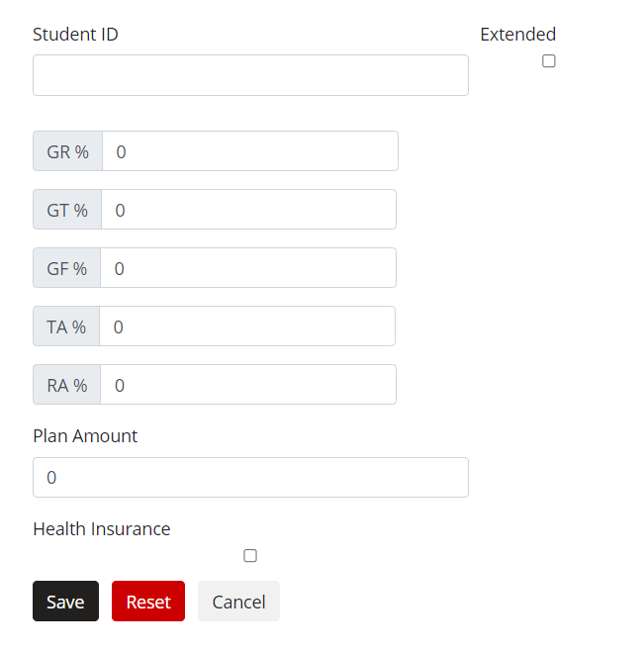
GSHIP enrollment
Department indicate if the student has elected GSHIP through the TB portal
We enroll students with UHCSR on a weekly basis, up to the close of the TB portal.
Student must have signed offer and be registered for nine (9) credit hours to be enrolled.
Please receive verification from the student he/she wants GSHIP.
Student are assessed a 20% GSHIP Fee
Once the TBP portal closes, changes to the insurance census are highly discouraged.
Manual process after fees are posted and students are enrolled

Slide 8
Department-paid enrollment
Some departments choose to pay premiums for students who don’t qualify for the regular subsidized program
Graduate students taking three (3) or more credits are eligible to enroll in the student health insurance plan
Most departments only need to enroll Graduate Fellows
Remember to report insurance payments/reimbursements made on behalf of students to Scholarship Administration
Miscellaneous Item Type
All coverage automatically terminates each year as of August 15. Students must be re-enrolled each Fall for coverage to continue.

Slide 9
Department paid enrollment
Use the provided department enrollment spreadsheet for United HealthCare, and/or enroll your students with EMI via the online portal. If you need access to the spreadsheet or portal and have not used them previously, contact the Graduate School.
Be sure to use the correct insurance location code – insurance location code is the same for UHCSR and EMI.
We will be having an EMI portal training session this August. More information to follow.
For the health plan, submit your spreadsheet to sidpremium@uhcsr.com
PLEASE add “PHI” to the beginning of your subject line to send securely
You will receive an invoice from UHCSR
The spreadsheet can also be used to update contact information or to remove coverage
For dental/vision enrollment, complete portal enrollment by the census deadline each semester
EMI will supply each department with a semester bill and an annual bill to facilitate payment. Failure to meet payment deadlines may result in termination of coverage.

Slide 10
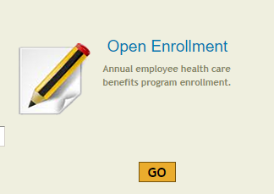
Enrollment methods overview
UHCRS
UHCSR Enrollment Spreadsheet
Enroll only Department-Paid students via department specific spreadsheet
The Graduate School will enroll students eligible for GSHIP
Email to spreadsheet to: SIDPremium@uhcsr.com
EMI
Department use EMI Health Enrollment Portal
Start with Open Enrollment for existing students
Found on the enrollment section
Use “New Hire” section to add new students
Enroll only Department-Paid students via Portal
The Graduate School will enroll students eligible for GSHIP
Complete initial enrollment by census deadline

Slide 11
Dependent Enrollment
GSHIP – Student Pay
UHCSR
Subsidized students must add dependents during UHCSR’s open enrollment period for each semester if not adding annual coverage in the Fall
They do not need to wait for their own coverage to be processed, but should follow these steps:
Go to www.uhcsr.com/utah
Click on “Enrollment Info,” and then “Dependent Coverage Page.”
This form reserves coverage for the student’s dependents. Once the student’s enrollment is processed by the University, the student should be billed for their dependents’ premium
EMI
Has a separate form for adding dependents to the vision/dental coverage
The form will be sent to the departments in August
Check the box at the top of the form indicating that the STUDENT is responsible for the premiums
Currently, the dependent enrollment form is the only method to enroll dependents for subsidized students
DEPARTMENTS - PLEASE EMAIL THE FORM WITH “PHI” IN THE SUBJECT HEADING TO TBELL@EMIHEALTH.COM.
Do not send the forms to the Tuition Benefit Office

Slide 12
Dependent Enrollment
GSHIP – department Pay
UHCSR
Add dependents using the department enrollment spreadsheet
If the student is eligible for GSHIP, you should still use your department enrollment spreadsheet (since your department is paying for the dependent premiums)
PLEASE do not change the student’s location -
EMI
Department-paid enrolled students
Use the EMI portal to enroll dependents
That the department is paying
Training will be available in August with EMI staff
Via Zoom

Slide 13
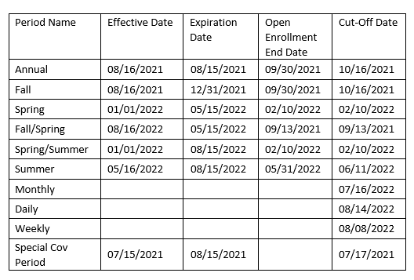
UHCSR open enrollment dates
These dates will be posted in the brochure and/or on the website for students and admin to see at any time. The cut-off date is the last date students are able to be enrolled in the plan for that period.

Slide 14
International students
The University wants to ensure that international students are fully covered by adequate health insurance while in the U.S.
https://studenthealth.utah.edu/international-students/
Each Semester, Student Health automatically enrolls students on F-1 and J-1 Visas in the voluntary student health plan
Fall 8/16-12/31
Spring/Summer 1/1 – 8/15
If an international student has an existing insurance plan, they may be eligible to apply for a waiver of the insurance requirement.
Students are bill via Income Accounting for the full premium at the start of each semester
They are NOT automatically enrolled in vision/dental plan (not mandatory)
Unless they are part of GSHIP, the TB Office will enroll the students

Slide 15
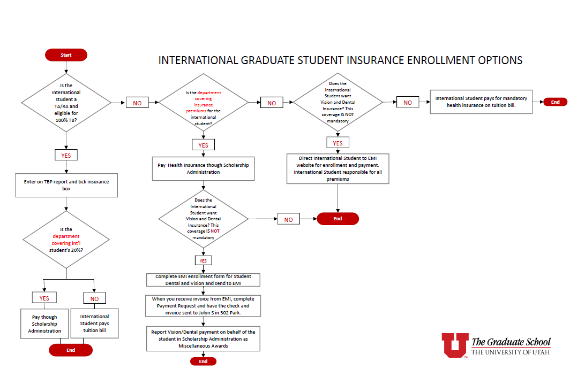
Also includes GR/GT
Enroll the student via EMI’s web portal

Slide 16
2021-2022 premiums
UHCSr
EMI
Tentative annual rate - $2,471
Major Changes
Prescription reimbursement increased to 90%
Removed barriers in submitting prescription receipts on a timely basis
Allow domestic partnerships effective 8/16/2022
Advantage Co-Pay (Dental)
Student Monthly Rate - $10.40
12% decrease from 2021-2022
VSP 10-130P (Vision)
Student Monthly Rate - $4.20
19% decrease from 2021-2022
Break in Coverage
EMI will allow the waiting period to be waived as long as there is no more that one (1) semester break in coverage
Student can also enroll in Voluntary plan

Slide 17
reconciliation
UHCRS
Request invoice from UHCSR
Review Data
Make any necessary changes via UHCSR’s spreadsheet
EMI
Fall Semester
Census of Enrollment to Graduate School – TBD
Census of Enrollment to Departments – TBD
Enrollment changes/Reconciliation via Portal – 10/1/2022
Spring Semester
Census of Enrollment to Graduate School – TBD
Census of Enrollment to Departments – TBD
Enrollment changes/Reconciliation via Portal – 3/01/2022

Slide 18
billing
EMI
Notification emailed to check EMI’s billing Portal
Fall – end of October 2022
Fall Semester
Annual
Recommended: pay if you know you will not have changes in the Spring
Pay invoice by 12/1/2022
Spring – End of March
Spring Semester
Pay invoice by 5/1/2023
UHCRS
Invoices Mailed for both semesters
Can request invoices at anytime during the semester

Slide 19
Dependent coverage
EMI
GSHIP
The Graduate School does not pay for dependent coverage
Need to complete EMI dependent coverage form
Send the form to directly to EMI
Dependent coverage follows the Student
Dependent coverage will appear on GSHIP Invoice
Graduate School will request a chartfield for dependent coverage when paying EMI invoice
UHCRS
GSHIP
The Graduate School does not pay for dependent coverage
Dependent coverage can be enrolled by the Department
Dependent coverage directly paid by the Department
The student can directly enroll their dependents via UHCSR website

Slide 20
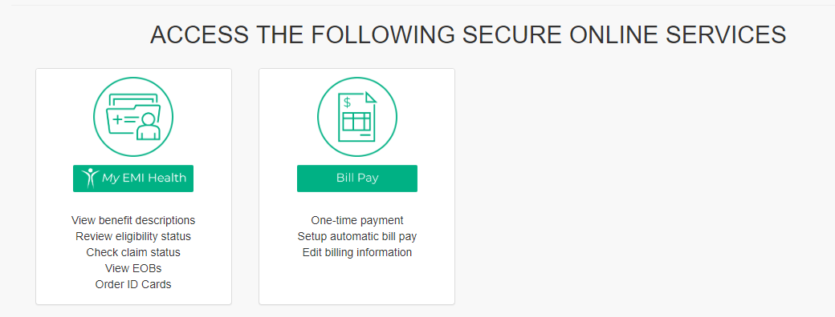
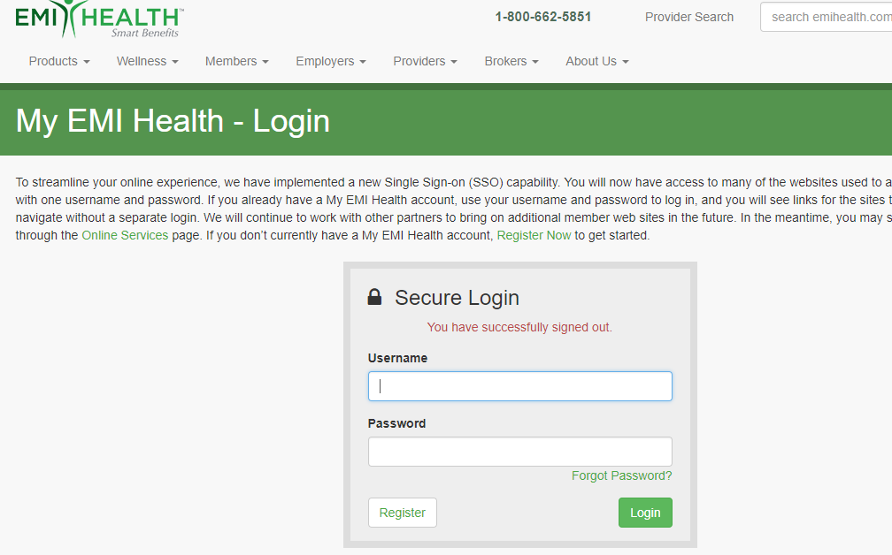
Emi portal
You will need to have both logins linked onto one page.

Slide 21
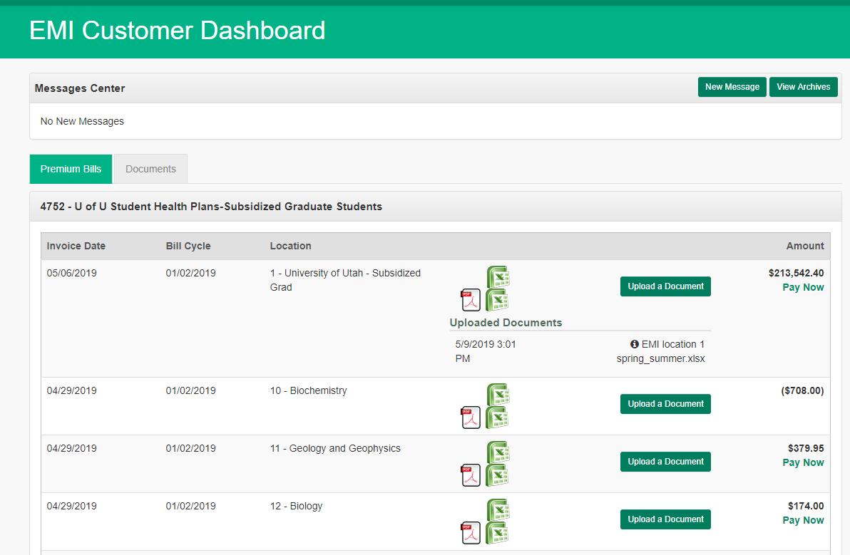
EMI billing portal
In the Fall, there will be two invoices
Look at the Invoice number to determine what invoice you’re reviewing
COMM4752………FALL
COMM4752………ANNUAL
If you make changes to your invoice, you should upload the revised invoice into the billing portal
Press the “Upload a Document” button.

Slide 22
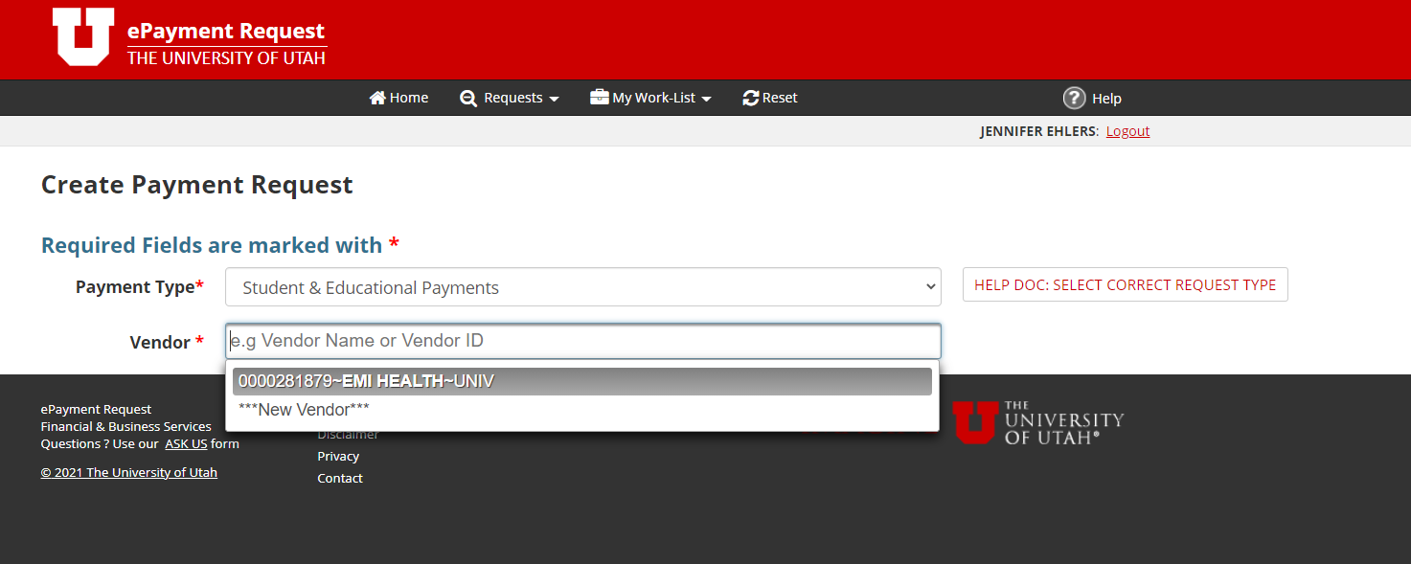
ePR – uhcsr/emi
Select payment type:
Student & Education Payments
Vendor Number:
0000041392-United Healthcare Student Resources
0000281879 – EMI Health
Change from prior years –
Other vendor number is inactive
Use Account Number:
65810 – Student Insurance

Slide 23
Scholarship administration
Payments made on behalf of a student should be recorded in Scholarship Admin
Misc. Item Type
Can report one total (Health + Vision/Dental)
If paying semester invoices, report Fall 2021 and Spring 2022 amounts
If paying an annual invoice, report the amount in the semester bill was paid

