Slide 1
National Science Foundation
Graduate Research Fellowship Program
Research Plan Statements
  Matthew Plooster, Ed.D.
  Graduate School Office of Fellowships & Benefits
  nsf-grfp.utah.edu | www.nsfgrfp.org

Slide 2
What We’ll Cover
NSF-GRFP and eligibility review
Research plan statements
    Getting started
    Considerations
    Intellectual merit & broader impact
    Suggested page structure
    Writing tips
FAQs
Resources

Slide 3
What is the NSF-GRFP
The NSF Graduate Research Fellowship Program (GRFP) helps ensure the vitality of the human resource base of science and engineering in the United States and reinforces its diversity. The program recognizes and supports outstanding graduate students in NSF-supported science, technology, engineering, and mathematics disciplines who are pursuing research-based master’s and doctoral degrees at accredited United States institutions.
As the oldest graduate fellowship of its kind, the GRFP has a long history of selecting recipients who achieve high levels of success in their future academic and professional careers. The reputation of the GRFP follows recipients and often helps them become life-long leaders that contribute significantly to both scientific innovation and teaching. Past fellows include numerous Nobel Prize winners, former U.S. Secretary of Energy, Steven Chu, Google founder, Sergey Brin and Freakonomics co-author, Steven Levitt.
- National Science Foundation

Slide 4
Fellowship Benefits
Five year fellowship
$37,000/year stipend for three years
Tuition coverage for three years
Career/life balance (family leave)
Access to other professional development opportunities
Health insurance coverage for three years*
$2,000/year research expenses for three years*
*specific to the University of Utah

Slide 5
Other Important Benefits
Mobile – you can take it anywhere in the US
Occasionally a step up in graduate admissions
Prestige & recognition
Boosts resume/CV
Establishes a pattern of seeking (and getting) external funding

Slide 6
Eligibility
Must be a US citizen, national, or permanent resident
Enrolled or intend to enroll in a research-based masters or doctorate in an eligible STEM field:
Chemistry
Computer and Information Science/Engineering
Engineering
Geoscience
Life Sciences
Materials Research
Mathematical Sciences
Physics & Astronomy
Psychology
Social Sciences
STEM Education

Slide 7
Eligibility
Who Isn’t Supported
Joint science/professional degree programs (example: JD/PhD)
Business administration or management degrees
Counseling, social work
History (except the history of science)
Education (except STEM education)

Slide 8
Eligibility
Who Isn’t Supported
Research with disease-related goals (unless biomedical engineering)
Clinical research:
    Patient-oriented research
    Epidemiological and medical behavioral studies
    Outcomes research
    Health services research
Pharmacologic, non-pharmacologic, and behavioral interventions & studies

Slide 9
Application Components
Transcripts – required from all degree-granting institutions you’ve attended
Statements – Personal Statement and Graduate Research Plan Statement
Reference Letters – two letters are required, but recommended to submit three

Slide 10
Research Plan Statements
“Research Plan Statement”
Maximum of 2 pages
Must address broader impacts and intellectual merit, each with their own unique header
Your opportunity to talk about who you are, how you’ve prepared for grad school and research, and your professional/leadership goals post-doctorate

Slide 11
Getting Started
Take time to reflect on the following questions:
What’s my research question and why is this important?
What is my proposed research project and how will it answer the question?
What do I hope to achieve with my research, what are my expected outcomes?
What is necessary for me to conduct this project? Resources, skills, PI support, etc.?
How have I prepared to execute this project? What preparation lies ahead of me?

Slide 12
Considerations: Research Problem
What is your research question? What is the problem you’re aiming to solve? How does it relate to solving human or societal problems?
Why is this still a problem? What’s wrong with existing solutions? How will your approach be different?
What do you expect to achieve in addressing your research question?

Slide 13
Considerations: Taking Action
Re your research question, what are you going to do to address the problem?
What are the necessary steps to take? (Coding, experiments, field research, data analysis.)
Be specific, but avoid minutiae
What is your timeline? Is it reasonable for a PhD student and what’s required for your program?

Slide 14
Considerations: Skills & Tools
What skills are necessary to execute your proposed project?
If you don’t have those skills, how are you addressing this?
What sort of resources are needed – equipment, etc.?
Do you have access to the tools and resources needed to execute your project? If not, how are you addressing this?
Are costs associated with your project?

Slide 15
Considerations: Research Risks
Identify where your research plan is vulnerable
Are you depending on a key relationship that isn’t formed or might not pan out?
Is there a key step that might not come to fruition, such as a field test site?
What about the vulnerabilities of your research project?
What are your contingencies should a vulnerable element fall through? What’s your plan B?

Slide 16
Considerations: Relationships
Do you have an appropriate PI/faculty mentor?
Do you require relationships with individuals or organizations outside of your graduate college/university? This could be a national lab, a researcher at another institution, a field test site/community organization?
Other necessary relationships?

Slide 17
Considerations: Audience
Who will benefit from your research, directly and indirectly? Who will be interested in your results?
Know who your reviewers are (generally – you won’t know them individually)
Other constituents: scientific community, government labs, etc.

Slide 18
Considerations: Communicating Results
What will you do with your results? How will you communicate the solution to the research problem you’ve investigated?
Do you plan to publish? What are the targeted journals ideal for your publishing your results?
Will you share your results at conferences (posters, panels, presentations, etc.)? Which conferences are of interest for this purpose?
Other efforts to communicate your results?

Slide 19
Considerations: ROI
Consider what this project (and the GRFP) will provide for you
    Provide stepping-stone into academia
    Learning new marketable skills
    Foot in the door at a national lab, government/nonprofit organization, etc.
    Other benefits?

Slide 20
Intellectual Merits/Broader Impacts
 | You (Personal Statement) | Your Work (Research Plan)
Intellectual Merit | Your merit: describe your motivation, ability, research experiences, preparation, achievements, perseverance, and your future goals (scholarly, professionally) | Merit of your work: describe your topic, innovation, rigor, creativity, new knowledge your research will create, and contributions to existing science
Broader Impacts | Your impact: describe your background, personal story, broadening participation, outreach, identity, initiative, leadership, communicating science | Impact of your work: describe the foundational nature, relevance, importance to society, and any educational or interdisciplinary connections of your research

Slide 21
Intellectual Merits
This is you describing the academic merits of your work, your research project:
The value of your project to your discipline and greater academia – what’s remarkable?
What is your contribution to existing science?
What is your innovative approach to your research?
Your research training – and forthcoming training.
How will you communicate your research? Be bold and state specifically your plan for presentations, journal publications, etc.

Slide 22
Broader Impacts
This is where you describe the greater reach of your research. Describe the communities your research will impact and how:
What is the importance of your research to society?
Describe the relevance of your research to the society.
Are any specific communities impacted? Who and how?
What are the interdisciplinary connections of your research? How will this project impact more than just your primary discipline?
What sort of outreach will you engage in?
What sort of leadership role will you have with your research?
Can you quantify your impact?

Slide 23
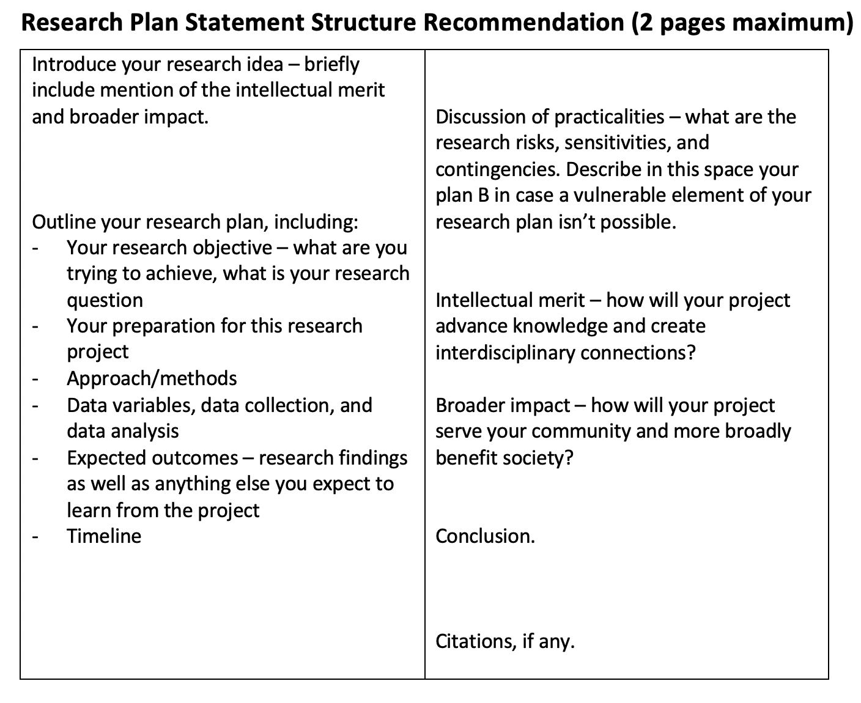
Suggested Page Structure

Slide 24
Introducing Your Plan
Consider one of the following hooks:
What are you hoping to solve with your project? What’s the question you’re answering?
What is innovative about your project?
What’s a problem left unsolved that you hope to solve? Why have other solutions been ineffective?
What broader impact are you hoping your project will have?

Slide 25
Outlining Your Plan
Introduction – what’s your hook?
Outline your plan – who | what | where | when | why | how
Discuss risk, practicalities
Intellectual merit & broader impact
Conclusion – strategic repetition
Citations

Slide 26
Writing Tips
Write clearly
Be pithy and succinct – only include what is necessary
Omit unnecessary language, especially technical jargon
Use shorter words over longer, more complicated vocabulary
Make sure each sentence is purposeful
Use effective repetition – past research experience, research skills, originality, awards and publications that support your work, etc.

Slide 27
Writing Tips
Originality is key
You need to weave into your narrative a statement of originality
How is this project different from what others have done?
The originality of your project, as illustrated in your research statement, should be corroborated by your PI in their recommendation

Slide 28
Writing Tips
Be confident in yourself
Remember that the NSF is funding you and your research project, not your PI’s lab (though they may be providing support…)
Take ownership of your scholarly and research path and career goals
Be honest about your preparation and acknowledge what needs to still happen
Talk about how your research history supports this research
Let your passion for your discipline and this project show

Slide 29
Writing Tips
What’s different?
Illustrate how your project is cutting-edge science
Projects shouldn’t be incremental – when talking about your project, don’t say “we’ve always done this, but I’m changing this one variable;” rather, be innovative and step outside of the box
Illustrate your originality – can’t be your PI’s idea, and they’ll be asked to confirm this

Slide 30
Writing Tips
What are you really showing?
You’re proposing a project, but you will not be locked into the complete proposal – things happen!
Your proposal illustrates what you’re capable of:
    Determining original research
    Conducting scalable and feasible research
    Crafting an innovative, cutting-edge project
    Considering risks and other important considerations
Show your acumen for this level of research

Slide 31
Writing Tips
Images?
Allowed – but they must fit into your two-page maximum statement
NSF recommends using images for equations rather than typing equations and symbols into your narrative (image keeps formatting from getting wonky)
Images – including graphs and figures – take up valuable real estate, ask yourself how purposeful the images are
When and where possible, use your own images
Images shouldn’t be too complicated to understand…

Slide 32
Writing Tips
References?
Allowed – but they must fit into your two-page maximum statement
Use, but use sparingly
Select the import impactful and respected publications
This is an opportunity to highlight your research as well as that of those who are informing your research (who are the leaders in your area of research?)
Remember: your paper will not be reviewed by a professor/research in your core discipline

Slide 33
Just Get Started!
Start with an outline – this will help you map out your thoughts into a cohesive and comprehensive structure
Plan to go through multiple drafts of your personal statement – proofread and edit before taking to others to proofread
Utilize writing resources – such as the U’s Writing Center – as you work on your draft
Word processing software spelling and grammar checks aren’t always accurate – when proofreading, check for good grammar and spelling

Slide 34
Proofreading & Seeking Feedback
Identify multiple proofreading partners – faculty mentor, classmate, friend/roommate, etc. – you want a variety of individuals from varying backgrounds
Spelling and grammar feedback is important and valuable, but feedback on your writing and narrative is a good focal point for proofreaders
Ask proofreaders to provide feedback on the flow of your paper, how your research is articulated, and if they walk away with a decent understanding of what you’re hoping to accomplish with your research
Plan to go through several rounds of proofreading and editing

Slide 35
Frequently Asked Questions
Q: How many drafts of my research statement should I go through?
A: This varies, but many successful applicants will go through 10+ rounds of proofreading and editing.
Advice: there is always the ability to continue “perfecting” our writing, but there is a point where you say it’s good enough for the purpose of the application.

Slide 36
Frequently Asked Questions
Q: How important is my faculty advisor re my research statement?
A: Your faculty advisor is key! They will attest to the originality of your project, as well as confirming that you will have the support necessary to complete your project.
This is particularly key for second-year applicants.
A note to first-year grad student applicants and rising seniors: reviewers understand that you might not have a significant relationship with your faculty advisor yet (or, particularly for rising seniors, even have an advisor). In these cases, other recommendation writers will be key in this process.

Slide 37
Frequently Asked Questions
Q: Should I have anyone other than my faculty advisor/PI review my research plan?
A: Yes. While your faculty advisor is your key partner in writing a great research statement, you want to have a diversity of perspectives. Classmates, other NSF graduate fellows, other faculty, etc.
Additionally, non-STEM proofreaders can be valuable in gauging how well your statement is written. While they might not understand the details and science behind your research projects, they should be able to walk away with an idea of what you’re trying to accomplish.

Slide 38
Frequently Asked Questions
Q: My PI is conducting research that is fascinating and I want to continue it in a new direction. Is this allowed?
A: Depends. The NSF is not utilizing the GRFP to fund your PI and their research initiatives; they’re funding you and your research.
NSF-GRFP research must be original. If you’re continuing your PI’s research agenda, that is not allowable. If you’re taking your PI’s completed and published research (as a scholar in your discipline) and taking a cutting-edge and original direction with it, that may be allowable.

Slide 39
Resources
Annual solicitation (nsfgrfp.org)
Previous workshops, tools, & resources found online (nsf-grfp.utah.edu)
Your faculty mentor
The University of Utah Writing Center (writingcenter.utah.edu)
Graduate fellowship advising (fellowships@gradschool.utah.edu)

Slide 40
Upcoming Workshops
June 8 – 1pm – Broader Impacts

Slide 41
Questions?
Matthew Plooster, Ed.D.
Director – Graduate Fellowships, Awards, and Benefits
Graduate School
801-581-6020
matthew.plooster@utah.edu
For NSF-GRFP application resources & trainings, visit www.nsf-grfp.utah.edu
For NSF-GRFP application portal and solicitation, visit www.nsfgrfp.org
To schedule advising appointments, email fellowships@gradschool.utah.edu

