Slide 1
National Science Foundation
Graduate Research Fellowship Program
Personal Statements
  Matthew Plooster, Ed.D.
  Graduate School Office of Fellowships & Benefits
  nsf-grfp.utah.edu | www.nsfgrfp.org

Slide 2
What We’ll Cover
NSF-GRFP and eligibility review
Personal statements
    Getting started/statement introduction
    Intellectual merits/broader impacts
    Writing about your experience
    Suggested page structure
    Writing tips
    Common weaknesses
    Drafting your statement
    Proofreading & seeking feedback
FAQs
Resources

Slide 3
What is the NSF-GRFP
The NSF Graduate Research Fellowship Program (GRFP) helps ensure the vitality of the human resource base of science and engineering in the United States and reinforces its diversity. The program recognizes and supports outstanding graduate students in NSF-supported science, technology, engineering, and mathematics disciplines who are pursuing research-based master’s and doctoral degrees at accredited United States institutions.
As the oldest graduate fellowship of its kind, the GRFP has a long history of selecting recipients who achieve high levels of success in their future academic and professional careers. The reputation of the GRFP follows recipients and often helps them become life-long leaders that contribute significantly to both scientific innovation and teaching. Past fellows include numerous Nobel Prize winners, former U.S. Secretary of Energy, Steven Chu, Google founder, Sergey Brin and Freakonomics co-author, Steven Levitt.
- National Science Foundation

Slide 4
Fellowship Benefits
Five year fellowship
$37,000/year stipend for three years
Tuition coverage for three years
Career/life balance (family leave)
Access to other professional development opportunities
Health insurance coverage for three years*
$2,000/year research expenses for three years*
*specific to the University of Utah

Slide 5
Other Important Benefits
Mobile – you can take it anywhere in the US
Occasionally a step up in graduate admissions
Prestige & recognition
Boosts resume/CV
Establishes a pattern of seeking (and getting) external funding

Slide 6
Eligibility
Must be a US citizen, national, or permanent resident
Enrolled or intend to enroll in a research-based masters or doctorate in an eligible STEM field:
Chemistry
Computer and Information Science/Engineering
Engineering
Geoscience
Life Sciences
Materials Research
Mathematical Sciences
Physics & Astronomy
Psychology
Social Sciences
STEM Education

Slide 7
Eligibility
Who Isn’t Supported
Joint science/professional degree programs (example: JD/PhD)
Business administration or management degrees
Counseling, social work
History (except the history of science)
Education (except STEM education)

Slide 8
Eligibility
Who Isn’t Supported
Research with disease-related goals (unless biomedical engineering)
Clinical research:
    Patient-oriented research
    Epidemiological and medical behavioral studies
    Outcomes research
    Health services research
Pharmacologic, non-pharmacologic, and behavioral interventions & studies

Slide 9
Application Components
Transcripts – required from all degree-granting institutions you’ve attended
Statements – Personal Statement and Graduate Research Plan Statement
Reference Letters – two letters are required, but recommended to submit three

Slide 10
Personal Statement
“Personal, Relevant Background, and Future Goals Statement”
Maximum of 3 pages
Must address broader impacts and intellectual merit, each with their own unique header
Your opportunity to talk about who you are, how you’ve prepared for grad school and research, and your professional/leadership goals post-doctorate

Slide 11
Getting Started
Take time to reflect on the following questions:
What’s unique, distinctive, and/or impressive about your story?
What details about you would help set you apart from others and help reviewers?
How did you become interested in your field? What have you learned about it? And what have you learned about yourself in the process?
What have you learned about the field through classes, readings, seminars, and other work experiences?
How have you capitalized on opportunities available to you?
What reasons can you give for reviewers to be interested in you?

Slide 12
Statement Introduction
Start your personal statement talking about you – it’s important to remember that the NSF-GRFP funds you as an individual, your scholarly/research, and your leadership potential.
Consider including the following:
Why you’re pursuing a graduate degree
Why you’re studying science and your specific field
What you’re most passionate about with science
Share an outstanding research experience
Challenges you’ve overcome

Slide 13
Statement Introduction
Suggested statement openers to hook your reviewer, sharing a story of…
Story of how you became interested in science
A unique research experience
Why you’re choosing to pursue a graduate degree and to research your specific project
A unique leadership or outreach experience relating to STEM
What in STEM you’re passionate about and why
Your broader impacts in the community
Your personal background that led you down this unique path

Slide 14
Intellectual Merits/Broader Impacts
 | You (Personal Statement) | Your Work (Research Plan)
Intellectual Merit | Your merit: describe your motivation, ability, research experiences, preparation, achievements, perseverance, and your future goals (scholarly, professionally) | Merit of your work: describe your topic, innovation, rigor, creativity, new knowledge your research will create, and contributions to existing science
Broader Impacts | Your impact: describe your background, personal story, broadening participation, outreach, identity, initiative, leadership, communicating science | Impact of your work: describe the foundational nature, relevance, importance to society, and any educational or interdisciplinary connections of your research

Slide 15
Intellectual Merits
This is you describing your potential to advance knowledge through research and scholarly activities
Your history as a student/scholar
Documented intellectual ability (GPA, awards, etc.)
Evidence of your ability to:
    Plan and conduct research
    Work independently
    Communicate research
    Take initiative, solve problems, persist

Slide 16
Broader Impacts
This is where you describe your impact on society, personally and through research.
Describe how you have impacted your community:
Participation with and impact on diverse populations
Outreach, teaching, mentoring, and impacting STEM education in schools and community
Community outreach: participation in and leadership of science clubs, writing/blogging/podcasts, other media
Impact in creating and cultivating a diverse workforce
Increase collaboration between academic and industry sectors

Slide 17
Writing About Experience
Describe the sort of projects you worked on
Who was your research advisor/faculty mentor/PI?
How did you get involved?
What was your role? Were you independent or part of a team?
What sort of skills and knowledge was gained from the experience?
What were the results (publications, presentations, recognition, etc.)?

Slide 18
Suggested Page Structure
Consider including the following elements in your narrative:
Your relevant background – where you have been
Your present – where you are today, in grad school – how you’ve prepared for graduate education and to be a leader and researcher
Your future – what you hope the next 30-ish years will look like for you – how you hope to grow as a researcher, professional, and leader

Slide 19
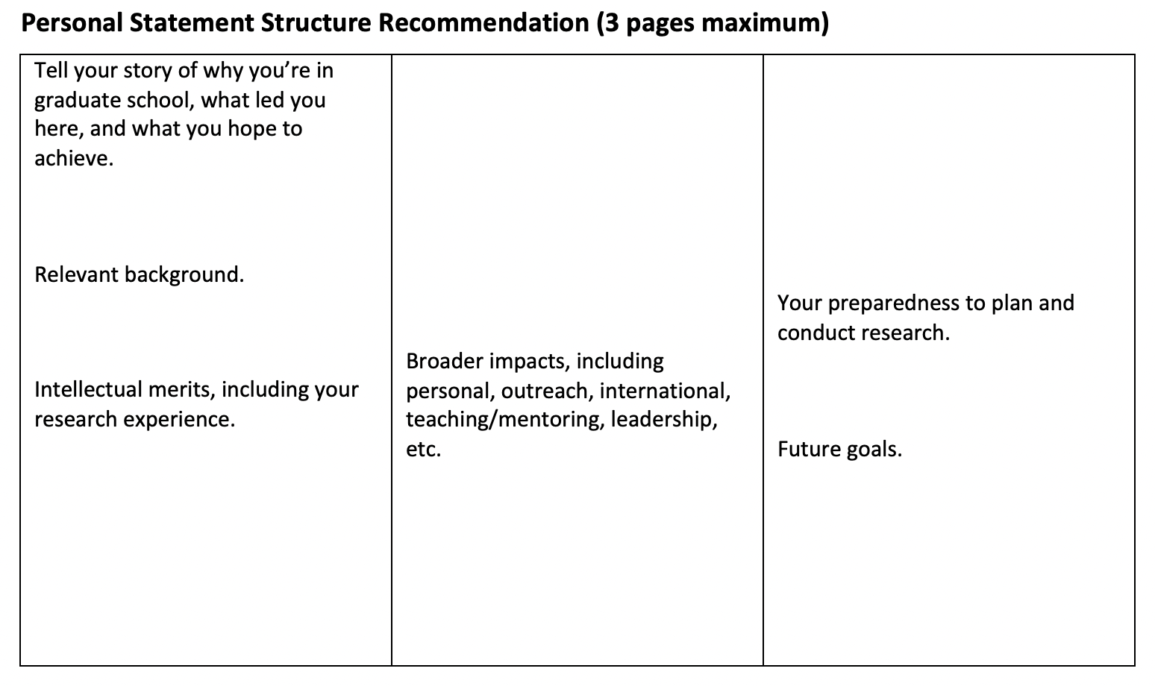
Suggested Page Structure

Slide 20
Writing Tips
Write clearly
Be pithy and succinct – only include what is necessary
Omit unnecessary language, especially technical jargon
Use shorter words over longer, more complicated vocabulary
Make sure each sentence is purposeful

Slide 21
Writing Tips
Know your audience
Keep in mind who your reviewers will be
Know what your audience is looking for
Write in a way that makes it easy for the reader to get the info they need to make a decision

Slide 22
Writing Tips
Be confident in yourself
Remember that the NSF is funding you not your PI or your research team
Take ownership of your scholarly and research path and career goals
Don’t understate your accomplishments
Highlight your role in your projects, research, and leadership roles
Write with “I” statements, as opposed to “we”
Tell your compelling story

Slide 23
Important Considerations
NSF-GRFP outreach goals – to attract a diverse and qualified applicant pool – with particular attention to:
Students attending Minority Serving Institutions (MSIs)
Students studying in EPSCoR jurisdictions,
Non-traditional education tracks

Slide 24
Non-Traditional Students
Non-traditional students are welcome & encouraged to apply! In your narrative, discuss the “why” behind returning to school
Why back to school now?
Why grad school, why this area?
What was your motivation to take this step?

Slide 25
Common Weaknesses
Unorganized personal statement that doesn’t tell a clear story
A research statement that is unclear, incomplete, or unpolished:
    Too much or too little detail
    Failure to “own” your research
    Lacking recognition of research risks
Dense writing that is difficult to understand or is uninteresting
Too much jargon
Failure to address your broader impacts

Slide 26
Drafting Your Statement
Start with an outline – this will help you map out your thoughts into a cohesive and comprehensive structure
Plan to go through multiple drafts of your personal statement – proofread and edit before taking to others to proofread
Utilize writing resources – such as the U’s Writing Center – as you work on your draft
Word processing software spelling and grammar checks aren’t always accurate – when proofreading, check for good grammar and spelling

Slide 27
Proofreading & Seeking Feedback
Identify multiple proofreading partners – faculty mentor, classmate, friend/roommate, etc. – you want a variety of individuals from varying backgrounds
Spelling and grammar feedback is important and valuable, but feedback on your writing and narrative is a good focal point for proofreaders
Ask proofreaders to provide feedback on the flow of your paper, how ideas are articulated, and if they walk away with a decent understanding of what you’re writing
Plan to go through several rounds of proofreading and editing

Slide 28
Frequently Asked Questions
Q: The personal statement limit is three pages – does this include sources or can I have another page for a bibliography?
A: The three-page limit is a maximum in total – you cannot exceed three pages to add a bibliography, appendix, etc. Your personal statement in total must not exceed three pages.

Slide 29
Frequently Asked Questions
Q: Can I use an image?
A: Yes! Images are allowed and, in some cases, encouraged.
When using equations in your statements, the NSF recommends using an image rather than typing out the equation in your text.
Caution: while images are allowed, remember that they do take up valuable space!

Slide 30
Frequently Asked Questions
Q: How many drafts of my personal statement should I go through?
A: This varies, but many successful applicants will go through 10-20 rounds of proofreading and editing.
Advice: there is always the ability to continue “perfecting” our writing, but there is a point where you say it’s good enough for the purpose of the application.

Slide 31
Frequently Asked Questions
Q: A few of my proofreading partners aren’t scientists or professors, should I take their advice on how I talk about my research?
A: Yes. While non-STEM proofreaders might not understand the details and science behind your research projects, they should be able to walk away with an idea of what you’re trying to accomplish; if they don’t, you may wish to edit.

Slide 32
Resources
Annual solicitation (nsfgrfp.org)
Previous workshops, tools, & resources found online (nsf-grfp.utah.edu)
Your faculty mentor
The University of Utah Writing Center (writingcenter.utah.edu)
Graduate fellowship advising (fellowships@gradschool.utah.edu)

Slide 33
Upcoming Workshops
June 1 – 1pm – Research Statements
June 8 – 1pm – Broader Impacts

Slide 34
Questions?
Matthew Plooster, Ed.D.
Director – Graduate Fellowships, Awards, and Benefits
Graduate School
801-581-6020
matthew.plooster@utah.edu
For NSF-GRFP application resources & trainings, visit www.nsf-grfp.utah.edu
For NSF-GRFP application portal and solicitation, visit www.nsfgrfp.org
To schedule advising appointments, email fellowships@gradschool.utah.edu

