Slide 1
TB Coordinator Town Hall November 29th, 2022

Slide 2
Introduction
Drop Vs. Withdraw
Drop for non-payment
Retroactive Drop
GSHIP Billing Information
General Q&A

Slide 3
Drop
Withdraw
Drops occur prior to the add/drop deadline* for the course. Students can complete 99% of drops on their own via their student homepage. If they are not able to, they should contact the Registrar’s office.
Dropped courses are not charged tuition.
Dropped courses do not appear on their transcript.
Dropped courses do not count towards Tuition Benefit Minimum enrollment.
https://registrar.utah.edu/handbook/drop.php
Withdraws occur when a student attempts to drop a course AFTER the add/drop deadline*. Students can withdraw, on their own, via their student homepage up to the midpoint of the course. After that time, they should contact the Registrar’s Office for instruction.
Withdrawn courses are still charged tuition.
Withdrawn courses still show on student transcripts with a “W” Grade.
Withdrawn courses do not count toward Tuition Benefit minimum enrollment.
Withdrawn courses are not covered by Tuition Benefit.
Additional Note: They will be paying at their residency rate for withdrawn courses. For example, if they are non-resident, they will be paying the full non-resident rate for the withdrawn course.
https://registrar.utah.edu/handbook/withdrawal.php
*Note that half semester courses and Miscellaneous session courses will have different add/drop deadlines. Their deadlines are prorated according to the dates of the course as entered in the system.

Slide 4
What does that mean for TB?
It is most ideal that a student work with their advisors/TB coordinators when considering dropping or withdrawing from courses. Dropping/withdrawing without advisement could leave the student without TB coverage.
As a reminder, a student must be enrolled for the minimum required credits to be eligible for TB (9 credits Fall/Spring, 3 credits Summer). Dropping or withdrawing courses could leave the student in a situation where that requirement isn’t being met, and therefore they lose Tuition Benefit for the semester.
Neither dropped or withdrawn courses count toward the credit minimum
Example 1: A student is in 12 credits and drops down to 9. They will still be covered in TB.
Example 2: A student is in 9 credits and drops down to 6. They will lose their TB.
Additionally, withdrawn courses are never covered by tuition benefit.
Example 1: A student is in 12 credits and withdraws down to 9. They will still be covered in TB, but they will be required to pay for the withdrawn course.
Example 2: A student is in 9 credits and withdraws down to 6. They will lose their TB.
In either case (drop or withdraw), the student can attempt to add courses onto their schedule to get back up to the required minimum credits. The student may need to work with the registrar’s office to add courses late where applicable. This is done via the Petition to Late Add process (https://registrar.utah.edu/handbook/lateadd.php). This process generally requires the approval signatures of one to two parties in the department offering the course. The most common solution we see is the addition of dissertation/thesis credits.
If your student does go below the minimum required credits, they will lose TB support. This is true even if they go below temporarily with the intention of adding more credits onto their record later. However, once they have added the new credits and are back up to the minimum requirements, their TB will be restored barring no other error messages or issues.
Information per TB guidelines: https://gradschool.utah.edu/funding/tbp/guidelines.php

Slide 5
Drop for non-payment and Tuition Benefit
Drop for non-payment occurs when a student have significant lack of coverage in their tuition. It only occurs ONCE during the semester, after the Census deadline. If a student is selected for drop for non-payment, they will have received multiple notices via Umail/Income Accounting.
Students who are correctly in the Tuition Benefit program should be held from being dropped for non-payment.
However, there are outliers where drop for non-payment may still occur. If a student contacts you for advisement after being dropped for non-payment do the following:
1- Check that they were entered into the TB portal correctly, and that they signed their TB agreement.
2- Contact us at tuitionbenefit@gradschool.utah.edu with a brief explanation of the situation. Please be sure to include the student’s name and UNID. We will contact Income Accounting to confirm the situation.
3a- If we find that the drop for non-payment is valid, we will inform you of such. It is then the student’s responsibility to remedy the situation. At that time, the student will need to decide if they want to attempt to be reinstated. Students who are interested in possible reinstatement need to contact Income Accounting to discuss the payment of their tuition.
3b- If we find that the drop for non-payment is invalid, we will discuss with Income accounting to determine what steps we can take to remedy the situation without student involvement.

Slide 6
Retroactive Drops
Retroactive drops are any drop that occur after the class has ended. These can only be approved by the Registrar’s Office via their Petition for Consideration for Exception to Policy process (https://registrar.utah.edu/handbook/exception.php).
If you have a student needing to consider this process, it is best that you contact the registrar’s office for instruction via their petitions email (petition@utah.edu). General submissions will require at minimum: The correctly completed form, a personal statement from the student describing the situation, a letter of support from the dean of their major college.
No petition is guaranteed. The registrar’s office has a committee of individuals who review each petition to determine whether it is approved or denied. That committee is made up of individuals from multiple offices associated with student support.
If a petition for retroactive drop is approved for the current semester, the course will be seen as a drop for that semester and therefore will act as a drop for TB purposes.
If a petition for retroactive drop is approved for a previous semester, please contact us to let us know so we can investigate if there will be any negative repercussions for student TB.

Slide 7
Retroactive Drops - Continued
When is it most appropriate for students to petition for retroactive drop?
Situations of University Error (such misadvisement by a university employee/faculty member)
Situations with emergencies well and truly beyond student control.
It is possible that a student will fall into one of these situations and still be denied.
No petition is guaranteed to be approved and will be reviewed carefully for each detail. Additional information may be requested of students for clarification.
In certain cases, a withdraw may be approved instead of a drop. Students may also choose to apply for the withdraw instead of the retroactive drop.

Slide 8
Retroactive Drops - Continued
For best information, contact the Registrar’s Office!
https://registrar.utah.edu/handbook/exception.php
petition@utah.edu
Registrar@utah.edu

Slide 9
Summary of Drops/Withdraws
Drops and Withdraws are not the same. While they may seem similar in many regards, a withdrawn course will always have an impact on the amount of tuition the student owes.
Additionally, in both the cases of drops and withdraws, a student may risk losing their TB coverage, even temporarily.
It is always best for a student to work with their advisors/TB coordinators before making any changes to their schedule.
Retroactive Drops/Withdrawals do exist, but have particularly difficult requirements for approval. Speak to the registrar’s office for more information.

Slide 10
GSHIP Billing Information

Slide 11
Enrollment Reconciliation
UHCRS
Request invoice from UHCSR
Review Data
Make any necessary changes via UHCSR’s spreadsheet
EMI
Spring Semester
Fall 2022 enrollment will roll over
Open Enrollment section will open mid-December
Census of Enrollment to Departments – 2/28/2022
Enrollment changes/Reconciliation via Portal – 3/15/2022

Slide 12
Billing
EMI
Notification emailed to check EMI’s billing Portal
Fall – Annual Invoice is now Available
You’ll need to request a FALL ONLY INVOICE if you anticipate enrollment changes in the spring
Annual
Recommended: pay if you know you will not have changes in the Spring
Pay invoice by 12/1/2022
Spring – End of March
Spring Semester
Pay invoice by 5/1/2023
UHCRS
Invoices Mailed for both semesters
Can request invoices at anytime during the semester

Slide 13
Dependent coverage
EMI
GSHIP
The Graduate School does not pay for dependent coverage
Need to complete EMI dependent coverage form
Send the form to directly to EMI
Dependent coverage follows the Student
Dependent coverage will appear on GSHIP Invoice
Graduate School will request a chartfield for dependent coverage when paying EMI invoice
UHCRS
GSHIP
The Graduate School does not pay for dependent coverage
Dependent coverage can be enrolled by the Department
Dependent coverage directly paid by the Department
The student can directly enroll their dependents via UHCSR website

Slide 14
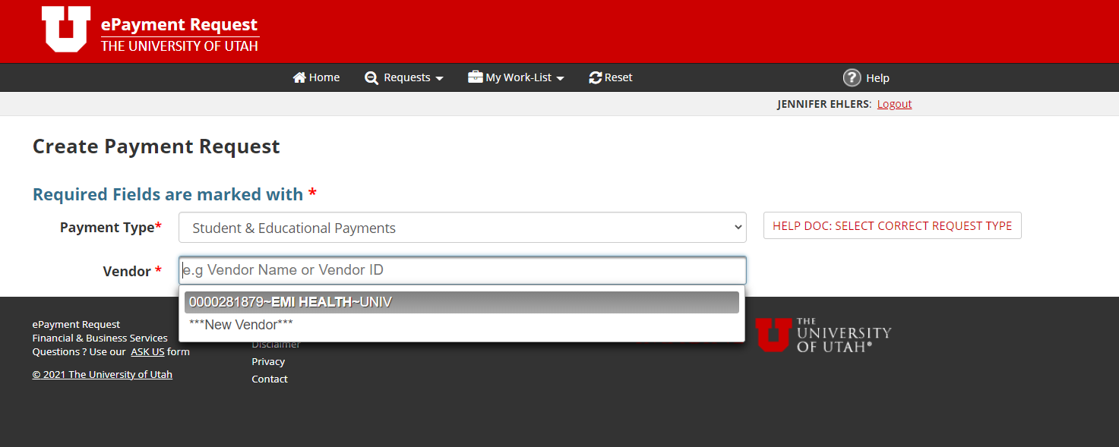
ePR – UHCSR/EMI
Select payment type:
Student & Education Payments
Vendor Number:
0000041392-United Healthcare Student Resources
0000281879 – EMI Health
Change from prior years –
Other vendor number is inactive
Use Account Number:
65810 – Student Insurance

Slide 15
Scholarship Administration
Payments made on behalf of a student should be recorded in Scholarship Admin
Misc. Item Type
Can report one total (Health + Vision/Dental)
If paying semester invoices, report Fall 2021 and Spring 2022 amounts
If paying an annual invoice, report the amount in the semester bill was paid

Slide 16
Q&A Time!

