Slide 1
National Science Foundation
Graduate Research Fellowship Program
Personal Statements Workshop
  Matthew Plooster, Ed.D.
  Office of Fellowships & Benefits
  The Graduate school

Slide 2
What is the NSF-GRFP
The NSF Graduate Research Fellowship Program (GRFP) helps ensure the vitality of the human resource base of science and engineering in the United States and reinforces its diversity. The program recognizes and supports outstanding graduate students in NSF-supported science, technology, engineering, and mathematics disciplines who are pursuing research-based master’s and doctoral degrees at accredited United States institutions.
As the oldest graduate fellowship of its kind, the GRFP has a long history of selecting recipients who achieve high levels of success in their future academic and professional careers. The reputation of the GRFP follows recipients and often helps them become life-long leaders that contribute significantly to both scientific innovation and teaching. Past fellows include numerous Nobel Prize winners, former U.S. Secretary of Energy, Steven Chu, Google founder, Sergey Brin and Freakonomics co-author, Steven Levitt.
- National Science Foundation

Slide 3
Fellowship Benefits
Five year fellowship
$34,000/year stipend for three years
Tuition coverage
Health insurance coverage*
$2,000/year research expenses for three years*
Career/life balance (family leave)
Access to other professional development opportunities
*specific to the University of Utah

Slide 4
Other Important Benefits
Mobile – you can take it anywhere in the US
Occasionally a step up in graduate admissions
Prestige & recognition
Boosts resume/CV
Establishes a pattern of seeking (and getting) external funding

Slide 5
Eligibility
Must be a US citizen, national, or permanent resident
Enrolled or intend to enroll in a research-based masters or doctorate in an eligible STEM field
    Chemistry
    Computer and Information Science/Engineering
    Engineering
    Geoscience
    Life Sciences
    Materials Research
    Mathematical Sciences
    Physics & Astronomy
    Psychology
    Social Sciences
    STEM Education

Slide 6
Eligibility
Who Isn’t Supported
Joint science/professional degree programs (example: JD/PhD)
Business administration or management degrees
Counseling, social work
History (except the history of science)
Education (except STEM education)

Slide 7
Eligibility
Who Isn’t Supported
Research with disease-related goals (unless biomedical engineering)
Clinical research:
    Patient-oriented research
    Epidemiological and medical behavioral studies
    Outcomes research
    Health services research
Ineligible studies include pharmacologic, non-pharmacologic, and behavioral interventions for disease or disorder prevention, prophylaxis, diagnosis, therapy, or treatment

Slide 8
Application Components
Transcripts – required from all degree-granting institutions you’ve attended
Statements – Personal Statement and Graduate Research Plan Statement
Reference Letters – two letters are required, but recommended to submit three

Slide 9
Personal Statement
“Personal, Relevant Background, and Future Goals Statement”
Maximum of 3 pages
Must address broader impacts and intellectual merit, each with their own unique header

Slide 10
Getting Started
Take time to reflect on the following questions:
What’s special, unique, distinctive, and/or impressive about your story?
What details about you would help set you apart from others and help reviewers?
How did you become interested in your field? What have you learned about it? And what have you learned about yourself in the process?
What have you learned about the field through classes, readings, seminars, and other work experiences?
How have you capitalized on opportunities available to you?
What reasons can you give for reviewers to be interested in you?

Slide 11
Statement Introduction
Start your personal statement talking about you – it’s important to remember that the NSF-GRFP funds you as an individual, your scholarly/research, and your leadership potential. Consider including the following:
Why you’re pursuing a graduate degree
Why you’re studying science and your specific field
What you’re most passionate about with science
Share an outstanding research experience
Challenges you’ve overcome

Slide 12
Statement Introduction
Suggested statement openers to hook your reviewer, sharing a story of…:
Your research experience, perhaps an experience that helped you determine to attend grad school
An example of your outreach experience
What in STEM you’re passionate about and why
Your broader impacts in the community
Your personal background that led you down this unique path

Slide 13
Intellectual Merit/Broader Impacts
 | You (Personal Statement) | Your Work (Research Plan)
Intellectual Merit | Your merit: describe your motivation, ability, research experiences, preparation, achievements, perseverance, and your future goals (scholarly, professionally) | Merit of your work: describe your topic, innovation, rigor, creativity, new knowledge your research will create, and contributions to existing science
Broader Impacts | Your impact: describe your background, personal story, broadening participation, outreach, identity, initiative, leadership, communicating science | Impact of your work: describe the foundational nature, relevance, importance to society, and any educational or interdisciplinary connections of your research

Slide 14
Intellectual Merits
This is you describing your potential to advance knowledge through research
Documented intellectual ability (GPA, awards, etc.)
Evidence of your ability to:
    Plan and conduct research
    Work independently
    Communicate research
    Take initiative, solve problems, persist

Slide 15
Broader Impacts
This is where you describe your impact on society, personally and through research
Describe how you have impacted your community:
    Participation with and impact on diverse populations
    Outreach, teaching, mentoring, and impacting STEM education in schools
    Community outreach: participation in and leadership of science clubs, writing/blogging/podcasts, other media
    Impact in creating and cultivating a diverse workforce
    Increase collaboration between academic and industry sectors

Slide 16
Writing About Experience
Describe the sort of projects you worked on
Who was your research advisor/faculty mentor?
How did you get involved?
What was your role? Were you independent or part of a team?
What sort of skills and knowledge was gained from the experience?
What were the results (publications, presentations, recognition, etc.)?

Slide 17
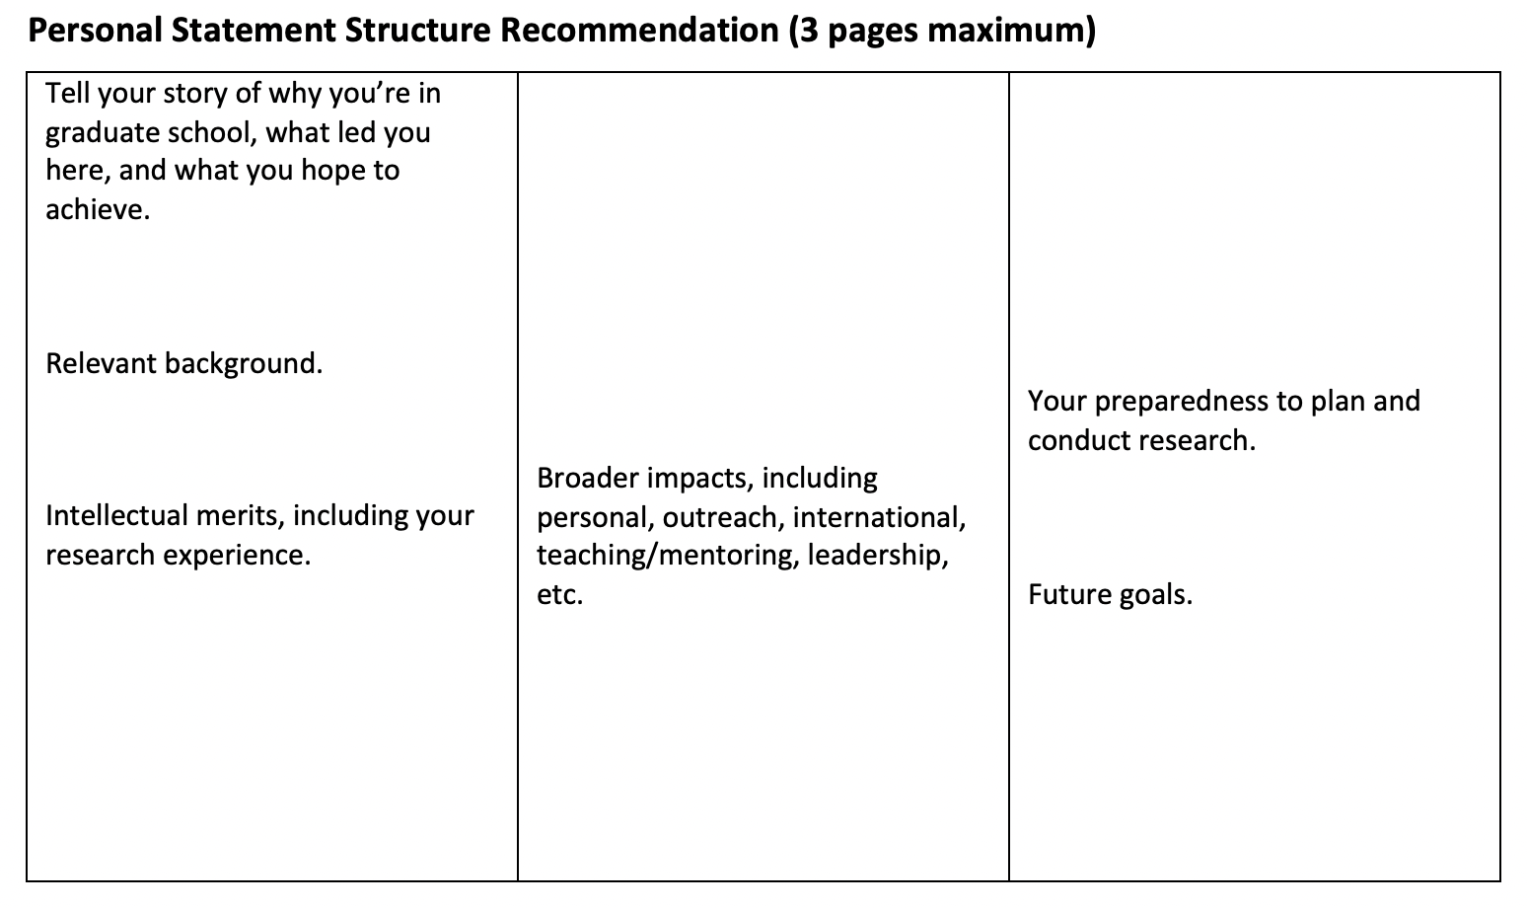
Suggested Page Structure

Slide 18
Writing Tips
Write clearly
Be pithy and succinct – only include what is necessary
Omit unnecessary language, especially technical jargon
Use shorter words over longer, more complicated vocabulary
Make sure each sentence is purposeful

Slide 19
Writing Tips
Know your audience
Keep in mind who your reviewers will be
Know what your audience is looking for
Write in a way that makes it easy for the reader to get the info they need to make a decision

Slide 20
Writing Tips
Be confident in yourself
Remember that the NSF is funding you not your PI or your research team
Take ownership of your scholarly and research path and career goals
Don’t understate your accomplishments
Highlight your role in your projects, research, and leadership roles
Write with “I” statements, as opposed to “we”
Tell your compelling story

Slide 21
Important Considerations
NSF-GRFP Outreach Goals
Attract a diverse and qualified applicant pool – with particular attention to:
    Students attending Minority Serving Institutions (MSIs)
    Students studying in EPSCoR jurisdictions,
    Non-traditional education tracks

Slide 22
EPSCoR
“Established Program to Stimulate Competitive Research (EPSCoR)”
NSF initiative to enhance research competitiveness of STEM research in designated states/territories
If you are from or completed undergrad in an EPSCoR jurisdiction, it may be an integral part of your story to discuss (how the locale may have impacted your trajectory)

Slide 23
EPSCoR
States/Territories:
Alabama
Arkansas
Delaware
Guam
Hawaii
Idaho
Iowa
Kansas
Kentucky
Louisiana
Maine
Mississippi
Montana
Nebraska
Nevada
New Hampshire
New Mexico
North Dakota
Oklahoma
Puerto Rico
Rhode Island
South Carolina
South Dakota
US Virgin Islands
Vermont
West Virginia
Wyoming

Slide 24
Non-Traditional Students
Non-traditional students are welcome to apply!
In your narrative, discuss the “why” behind returning to school
    Why back to school now?
    Why grad school, why this area?
    What was your motivation to take this step?
    How did you spend your time away from school?

Slide 25
Common Weaknesses
Unorganized personal statement that doesn’t tell a clear story
Dense writing that is difficult to understand or is uninteresting
Too much jargon
Failure to address your broader impacts

Slide 26
Drafts
Start with an outline, your thoughts mapped out
Go through multiple drafts of your personal statement
Ask your faculty mentor, classmate, parent/sibling to proofread and provide feedback

Slide 27
Resources
Annual solicitation (nsfgrfp.org)
Previous workshops, tools, & resources found online (nsf-grfp.utah.edu)
Your faculty mentor
The University of Utah Writing Center (writingcenter.utah.edu)
Graduate fellowship advising

Slide 28
Upcoming Workshops
June 29, 10am: Articulating Broader Impacts
July 6, 10am: Crafting Graduate Research Plans

Slide 29
Questions/Contact
Matthew Plooster, EdD
    Office of Fellowships & Benefits
    The Graduate School
    801-581-6020
    fellowships@gradschool.utah.edu
    nsf-grfp.utah.edu

