Slide 1
Tuition Benefit Program Extended Tuition Benefits (XTBP) Overview
Jennifer Ehlers
Accounting & Budget Manager
The Graduate school

Slide 2
Extended Tuition Benefit Program (XTBP)
XTBP can be used for the following:
Extend tuition benefits for those students who have utilized all their eligible semesters
Allocate an RA’s tuition benefits to a project that has tuition budgeted
Allocate a student’s tuition benefits to an activity

Slide 3
Extended Tuition Benefit Program (XTBP)
Like the traditional Tuition Benefit, XTBP consists of resident tuition and mandatory fees.
If you’re paying tuition through Scholarship Administration, coursework tuition is posted at the resident or non-resident rates
Dissertation Tuition is posted at reduced rates (Ph.D. students only, courses 7970-7989)
If you’re paying tuition through Scholarship Administration, tuition related to dissertation hours is posted at the resident rate
However, if the student has one or more credit(s) in coursework AND is a NON-resident, tuition will post at the non-resident rate.
Notes:
SCH is a budget/revenue term, and it looks like you’re simply referring to enrollment and tuition charges. You may wish to make changes.
Re mentioning tuition res/non-res rates and Scholarship Admin: other than summer, when all tuition is assessed at the resident rate, tuition is always billed at the appropriate residency rate for that individual student; so if a department is covering tuition through Scholarship Administration, they don’t benefit from the non-resident waiver.
Also dissertation hours are by catalog distinction, which you may wish to mention (7970-7989)
5/23/2020 – updated

Slide 4
XTBP Program Guidelines
Like traditional tuition benefit program -
Full-time, matriculated graduate students in good academic standing
Maintain a minimum cumulative GPA of 3.0 (Law School – 2.0).
Registration for at least nine (9) credit hours throughout the semester (Fall and Spring).
FTE cannot exceed .74
An FTE of .5 is the recommended maximum
Categories of Supported Grad Students
Payroll
Graduate Research Assistant (RA)
Grad Assistant-Research Focus (GR)
Grad Teaching Assistant (TA)
Grad Assistant-Teaching Focus (GT)
Requires coordination with ITA Program
Graduate Fellow (GF)
Notes:
GT doesn’t require “permission” from Diane, but coordination with ITAP and clearance to be a TA.
5/23/2022 - Updated

Slide 5
XTBP Does Not Cover
Differential tuition
Fees outside of mandatory fees
Undergraduate courses
Repeated courses (outside those required by curriculum)
Graduate credits exceeding 12.0
Non-credit/continuing education courses
Withdrawn courses
Audited courses
International student fees
Notes:
Font is very small, may wish to increase.
With making up the differences in enrollment, are you aiming to say thesis/dissertation hours?
I wouldn’t mention the 16 hours as 1) that is not a TBP policy, and 2) we have plenty of students with approvals for 16.5+ enrollments. Just mention that TBP will only cover up to 12 graduate credits and anything in excess is the student’s responsibility (which the department may choose to cover).
5/23/2022 – Used your slide -

Slide 6
XTBP – Financial Support
Semester | 100% Benefit | 75% Benefit | 50% Benefit
Summer 2022 | $5,380 | $4,034 | $2,690
Fall 2022 | $8,355 | $6,265 | $4,175
Spring 2023 | $8,355 | $6,265 | $4,175
Summer 2023 | $5,570 | $4,175 | $2,785
Notes:
Perhaps use the same table that I included in the previous presentation rather than using bullets.
5/23/2022 - Updated

Slide 7
XTBP- Service Requirements
Graduate students receiving a tuition benefit are expected to fulfill the responsibilities appropriate to their specific assignments.
No student is required to work more than 20 hours a week (0.50 FTE) in order to receive a tuition benefit.
Faculty may expect up to
20 hours of work a week (0.50 FTE) from students receiving a 100% tuition benefit
15 hours a week (0.375 FTE) from students receiving a 75% tuition benefit
10 hours a week (0.25 FTE) from students receiving a 50% tuition benefit
Students working one or more on-campus jobs with a combined FTE greater than a 0.74 FTE are ineligible to participate in the Graduate Tuition Benefit Program.
Notes:
Why all caps on header?
5/23/2022 – Updated

Slide 8
XTBP – 1001 Funds and GR Job Codes
In Fall 2022, we received confirmation from Mark Winter and Sandy Hughes regarding the use of 1001 Funds for Research Activities.
According to the Utah Board of Higher Education, fund sources should match the students’ work roles for payroll and XTBP.
If the primary work of the student is supporting the educational mission of the University, then the use of 1001 funds for tuition would be appropriate.
If the student's primary work is supporting the university’s research mission, then the use of other funds (2000, 2500, 5000, 6000) for tuition would be appropriate.
RAs payroll can be posted to a project, and the PI can cover tuition from an Activity.
If a student’s primary work is supporting the university’s research mission and you have fund 1001 for XTBP (i.e., old start-up fund), please email us at tuitionbenefit@gradschool.utah.edu to document and request an exception.
There are GRs whose primary function is to support the university’s education mission. Please email us at tuitionbenefit@gradschool.utah.edu to document the exception.
Notes:
Font is terribly small.
Why all caps on header?
No longer “regents” policy, but the Utah Board of Higher Education.
What do you mean by “we know that funds are not always available for XTBP?” Do you mean that project funds aren’t always available? Using 1001 is perfectly acceptable for XTBP, so it shouldn’t be phrased in a way that makes 1001 funds look like an exception to policy.
Avoid phrases like “we know” as this doesn’t appear as if this is reflecting official policy and procedure.
5/23/2022 – Updated – this is a slide that Mark/Sandy/Dave assisted with when we first started xTBP and noticed GRs being charged to 1001 funds. The intent is to recognize that there may not be other funds available for XTBP and if you need an exception to the rule, the department needs document the exception for Dave to approve. I don’t remember very may GRs on 1001 funds in FY22. I had used UBHE, but Dave changed it in 2020 – I was told that using 1001 funds for research is not acceptable – we can use 1001 for the educational mission of the University. I updated the wording on the 3rd bullet point to be clearer as it relates to research and 1001 funds

Slide 9
XTBP – Sponsored Projects
The project MUST have a tuition waiver budget (6660B)
Tuition is considered a restricted allowable cost
GCA requires a budget for tuition, so they know the PI/Dept has coordinated with the sponsor on approving tuition as an allowable expense on the project.
Payroll and Tuition Allocation
% of student’s effort on a project = % of student’s tuition remission charged to that project
If 100% of a student’s payroll (effort) is being charged to a sponsored award, we will allocate 100% of the student’s TB.
If 75% of a student’s payroll (effort) is being charged to a sponsored award and 25% to an activity, we will allocation the tuition as a 75% / 25% split of the students TB.
Notes:
Formatting isn’t consistent (why is it all bold and why is the header in all caps when other headers are not?)
First effort reporting bullet: it’s not an issue of “we can allocate,” but a procedure of the tuition benefit *will* be allocated. Use of “we can” makes it sound like we’re making exceptions.
In your last bullet: needs to say that the percentage of effort equals the percentage of tuition remission *charged to that project*
5/23/2022 – Ah, thank you for that clarification between can/will - ☺ updated wording on last bullet point

Slide 10
XTBP – Sponsored Projects
Enrollment and Other Schedule Changes (https://osp.utah.edu/policies/procedure-library/tuition-on-grants.php)
The PI and/or Department must notify the OSP, Graduate School, and Scholarship Administration when a student changes status mid-project, (i.e., leaves the project, school, or otherwise changes their work effort throughout of a budget period).
Compensation expenses to a sponsored award, including tuition, must accurately reflect the student's total effort on the sponsored award over the period in which tuition remission is provided.
Options to manage student enrollment/employment changes will include requiring students to reimburse pre-paid tuition on a pro-rata basis or using department funds to cover cost differences.
If there are no department funds to cover the pro-rata tuition remission, if eligible, the student’s tuition benefit record will be updated to traditional tuition benefits.
A journal entry or cost transfer must be processed to reallocate the unallowable tuition remission from the sponsored award
If not eligible, the student will lose their benefit.
Notes:
Formatting is off, why all bold and caps (header)?
5/23/2022 – updated header -

Slide 11
XTBP – Sponsored Projects
Tuition Cap
As more sponsored awards include tuition costs, please keep in mind:
A graduate student’s “compensation” is an aggregate total of salary/stipend, benefits, and tuition. This compensation total may not exceed the NIH’s postdoc stipend level for 0 years of experience.
Please work with your Grants & Contracts Accounting team if you have any questions.
Notes:
Formatting is off, why all bold and caps (header)?
5/23/2022 – updated header -

Slide 12
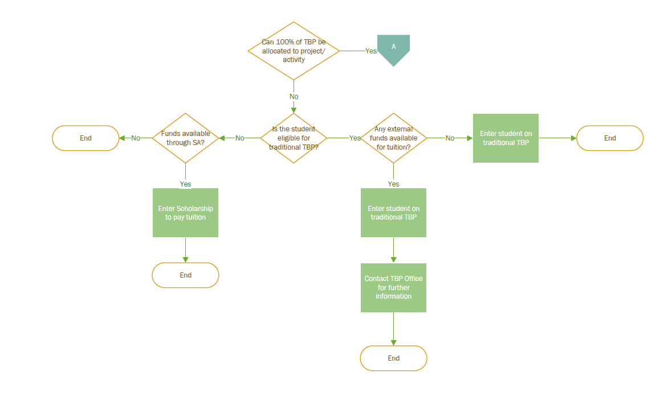
XTBP – Flowchart
Notes:
Add a header

Slide 13
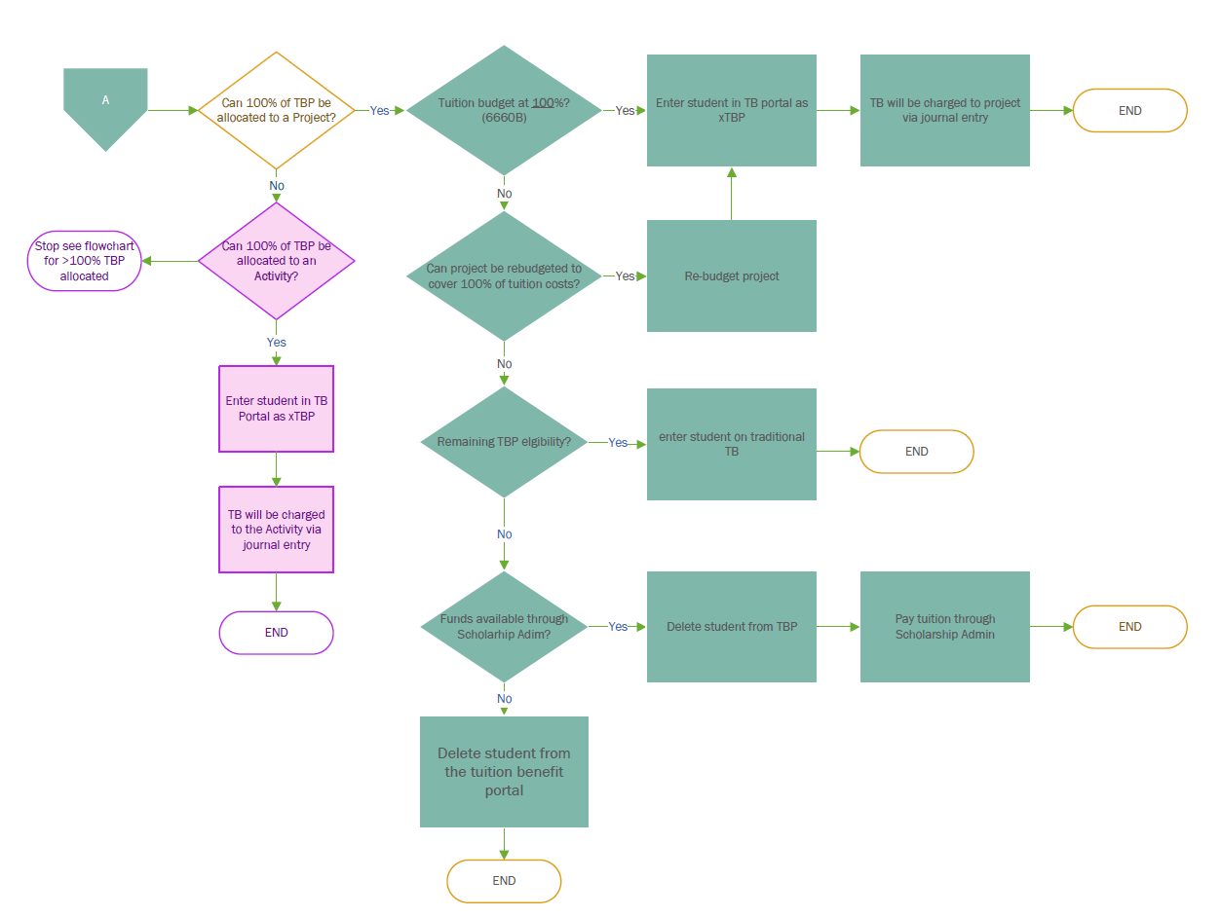
XTBP – Flowchart
Notes:
Add a header.
Doesn’t reflect how a student might be supported on a project and an activity.
5/23/2022; I don’t understand your comment. Both Activity and Projects are reflected on this slide – update the colors to differentiate between the two -

Slide 14
XTBP – When to use xTBP
100% XTBP Charged to Project/Activity
Less than 100% XTBP charged to Project/Activity
The student is eligible for XTBP
Select the extended box found in the TB portal
Chartfield section will appear
Pre-populated with BU and Account
The student is not Eligible for XTPB
The student will be entered into the TBP portal as a traditional student
Contact tuitionbenefit@gradschool.edu
Let us know the % or $ of tuition that can be charged to the project/activity
Notes:
Why all caps on header? What do you mean by “decision?” Also, the formatting is off and your image is covering text. May wish to separate into two slides if space is an issue.
5/23/2022 – Updated header and fixed tables

Slide 15
Xtbp - timeline
End of Month
Process XTBP journal entries
State Census
(15th day of the semester)
Validate projects for Tuition Budgets
Continue to process journal entries through semester
Final semester XTBP changes may need to be processed as a cost transfer
Six weeks prior to the start of the semester
17th – 19th day of the semester
TBP Portal Opens
TBP Portal closes
xTBP Data to Fellowships/ Benefits
Month that the portal closes
Fall – January 8th
Spring – May 25th
Summer – August 23rd
Notes:
Need to add about the finaling process where adjustments will be made as necessary (as is reflected on the next slide).
5/23 – updated last point to reflect final changes; changed the date to reflect the day after last payroll.

Slide 16
XTBP – Allocation of Tuition Remission
It’s a manual process via journal entries
No automatic interface with income accounting, general/project accounting
We start processing journal entries after the portal closes using TBP conditional dollar amounts
After we final for the semester, we review to ensure there are no changes to the original journal entries
If there are changes, we may need the department’s help processing a cost transfer to adjust the original charges
Notes:
Needs a header.

Slide 17
QUESTIONS ????

